Slide 1
Introduction to Computing for Data Analysis
Logistic regression (classification)
Richard Vuduc, Ph.D.
Associate Professor
School of Computational Science and Engineering
Gradient ascent
Notes:
Hello there! I’ve got some good news: you’re ready for the final part of logistic regression!
For this lesson, I’d like to introduce you to the technique of *gradient ascent,* which you can use to fit the logistic classifier to data.
That will complete the “logistic regression” problem. So let’s dive in!

Slide 2
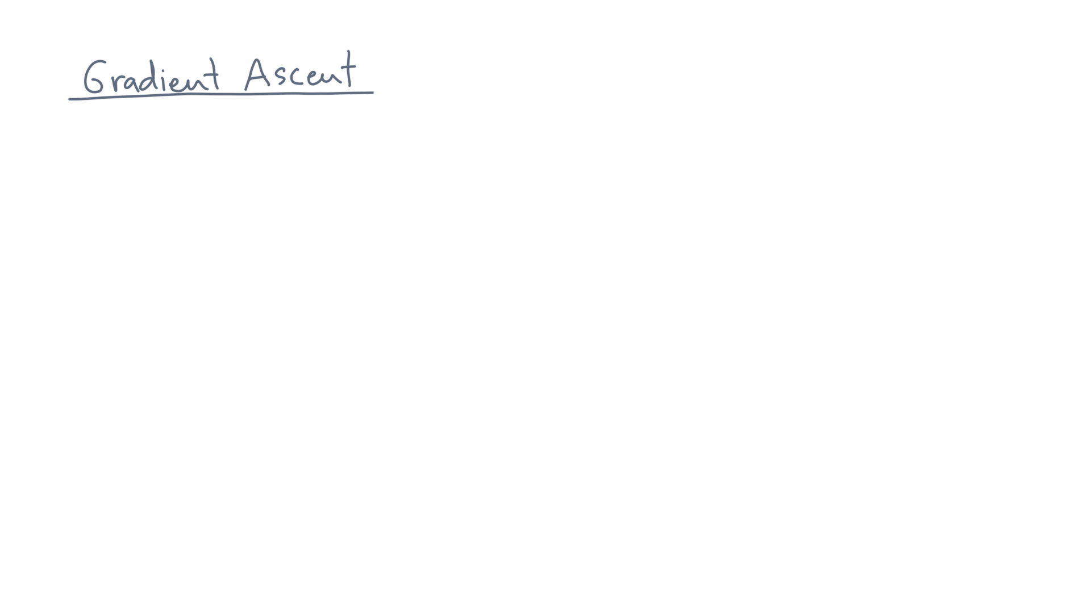
Notes:
Let’s begin with a generic optimization problem:

Slide 3
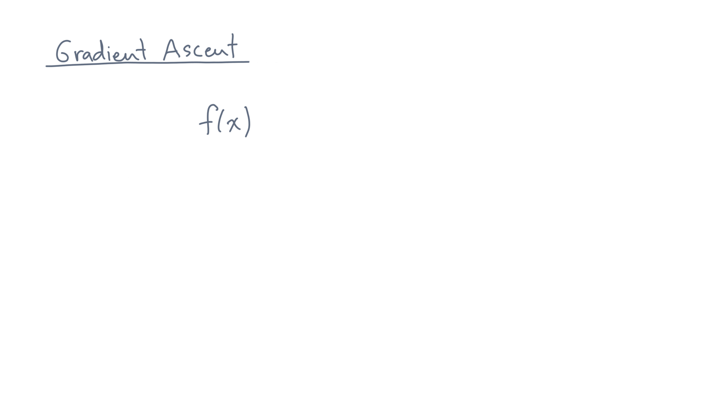
Notes:
Let’s say you are given a function, f(x).

Slide 4
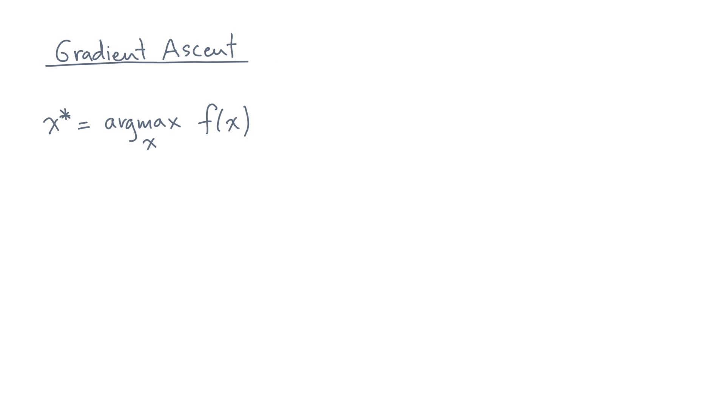
Notes:
And let’s suppose you want to find the location, x_*, of its maximum value.

Slide 5
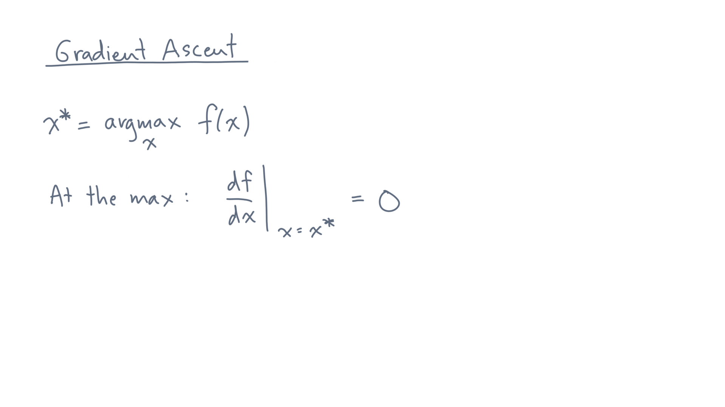
Notes:
If f is a scalar function, then you know that the first derivative will be zero at the max.

Slide 6
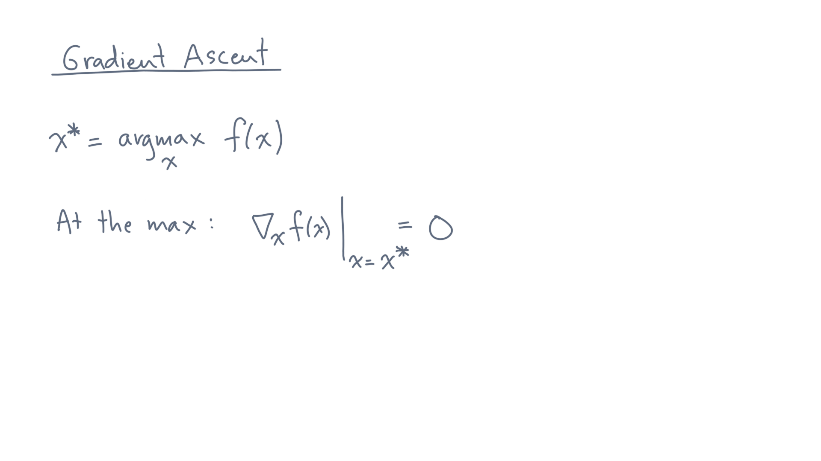
Notes:
Or, if x is a vector, then the gradient will be zero.

Slide 7
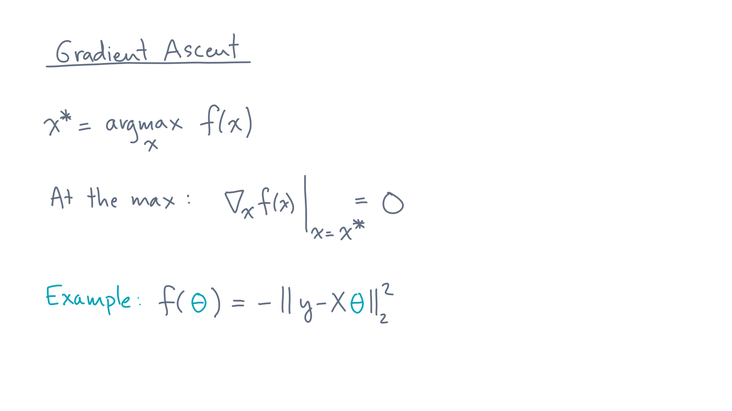
Notes:
For instance, for linear regression, we want to minimize the residual error, or, equivalently, maximize the negative of the residual error.

Slide 8
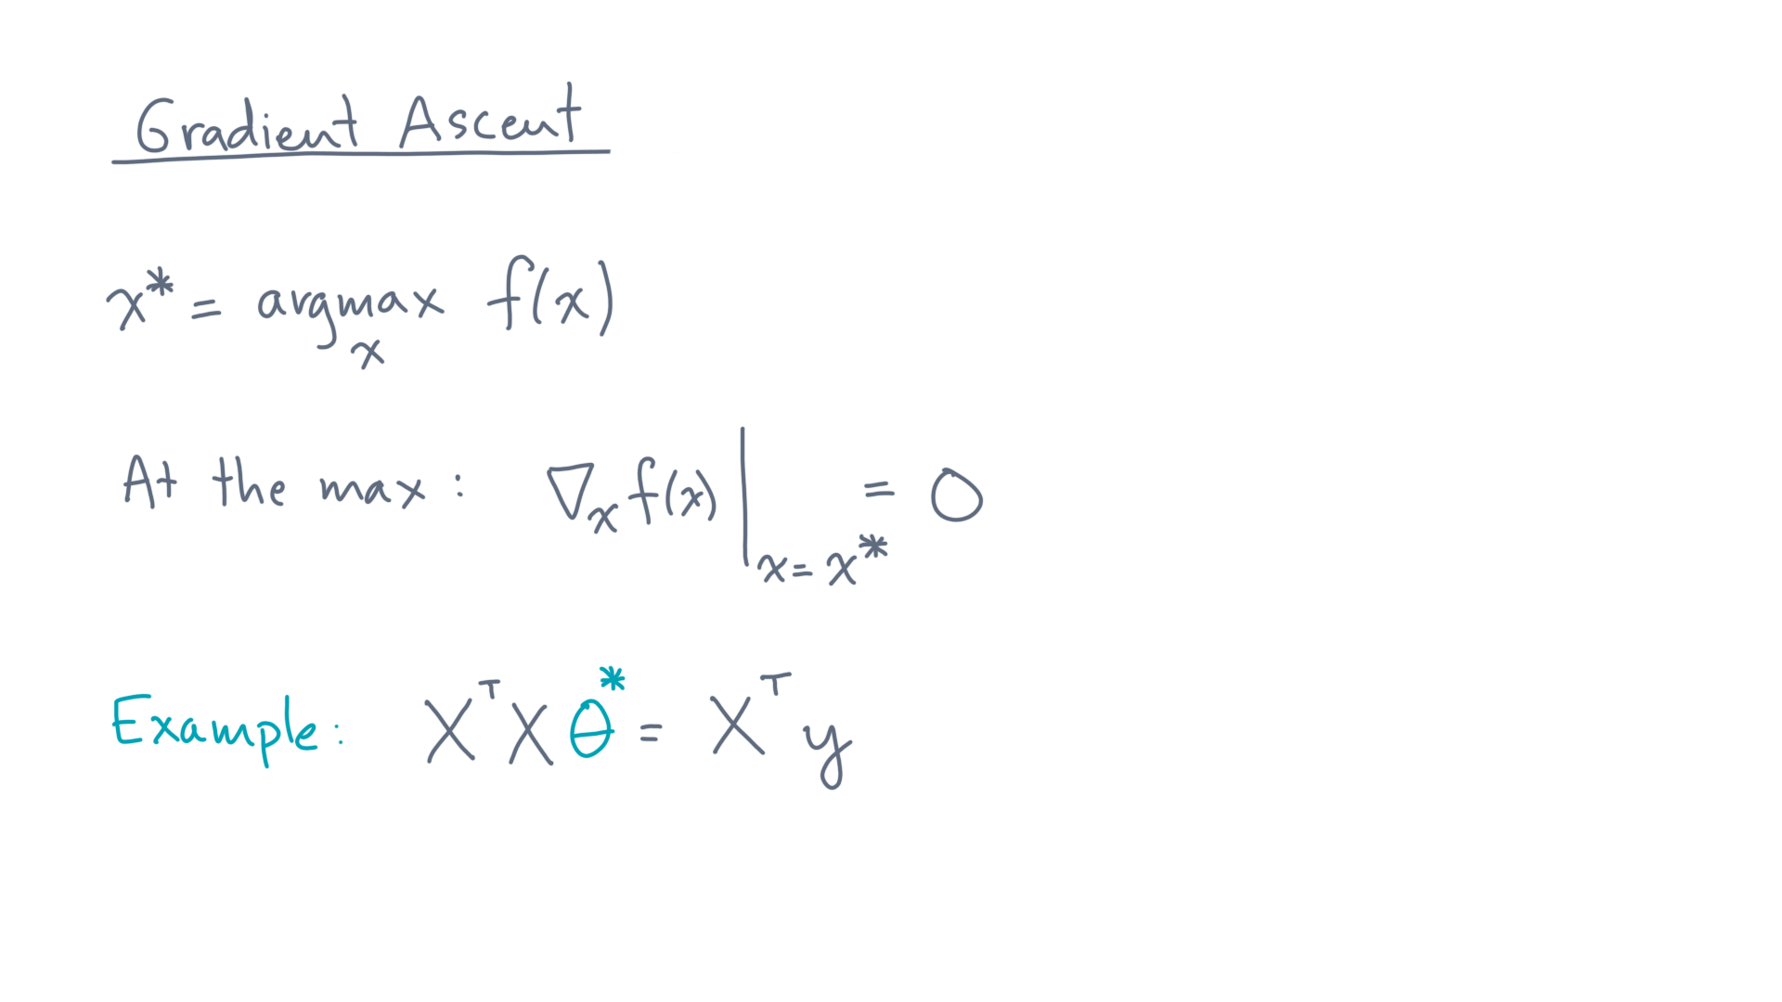
Notes:
Computing the gradient and setting it to zero, you’d find that the optimal parameters, theta-star, occurs at the solution to the normal equations.

Slide 9
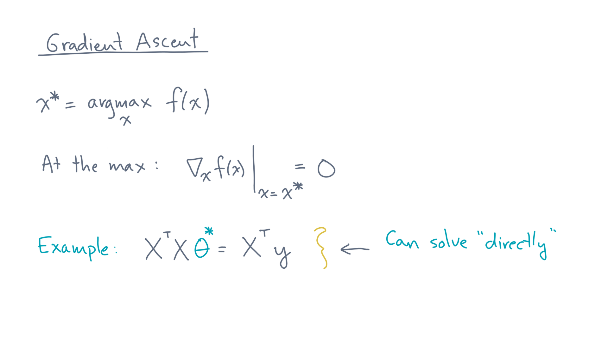
Notes:
This example is especially nice because you can compute the solution “directly.”
By that I mean there are canned solvers that are guaranteed to produce a good solution in a finite number of steps.

Slide 10
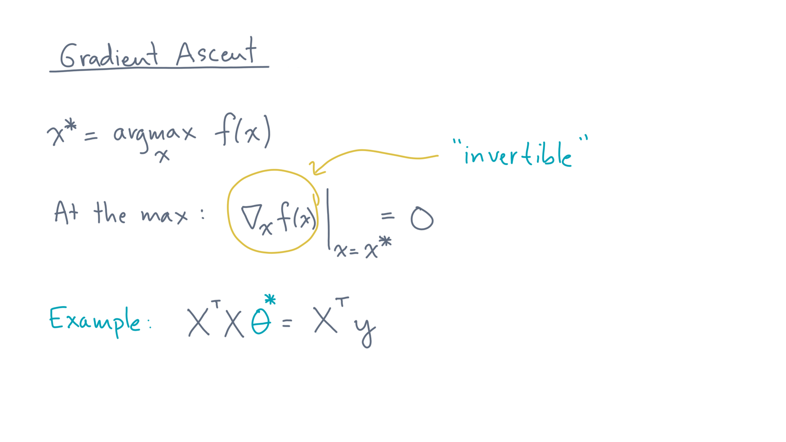
Notes:
Here’s another way to put it:
The gradient is a relatively simple function that is not too hard to invert.

Slide 11
Notes:
However, in general, that won’t be the case, and you’ll need a different procedure.

Slide 12
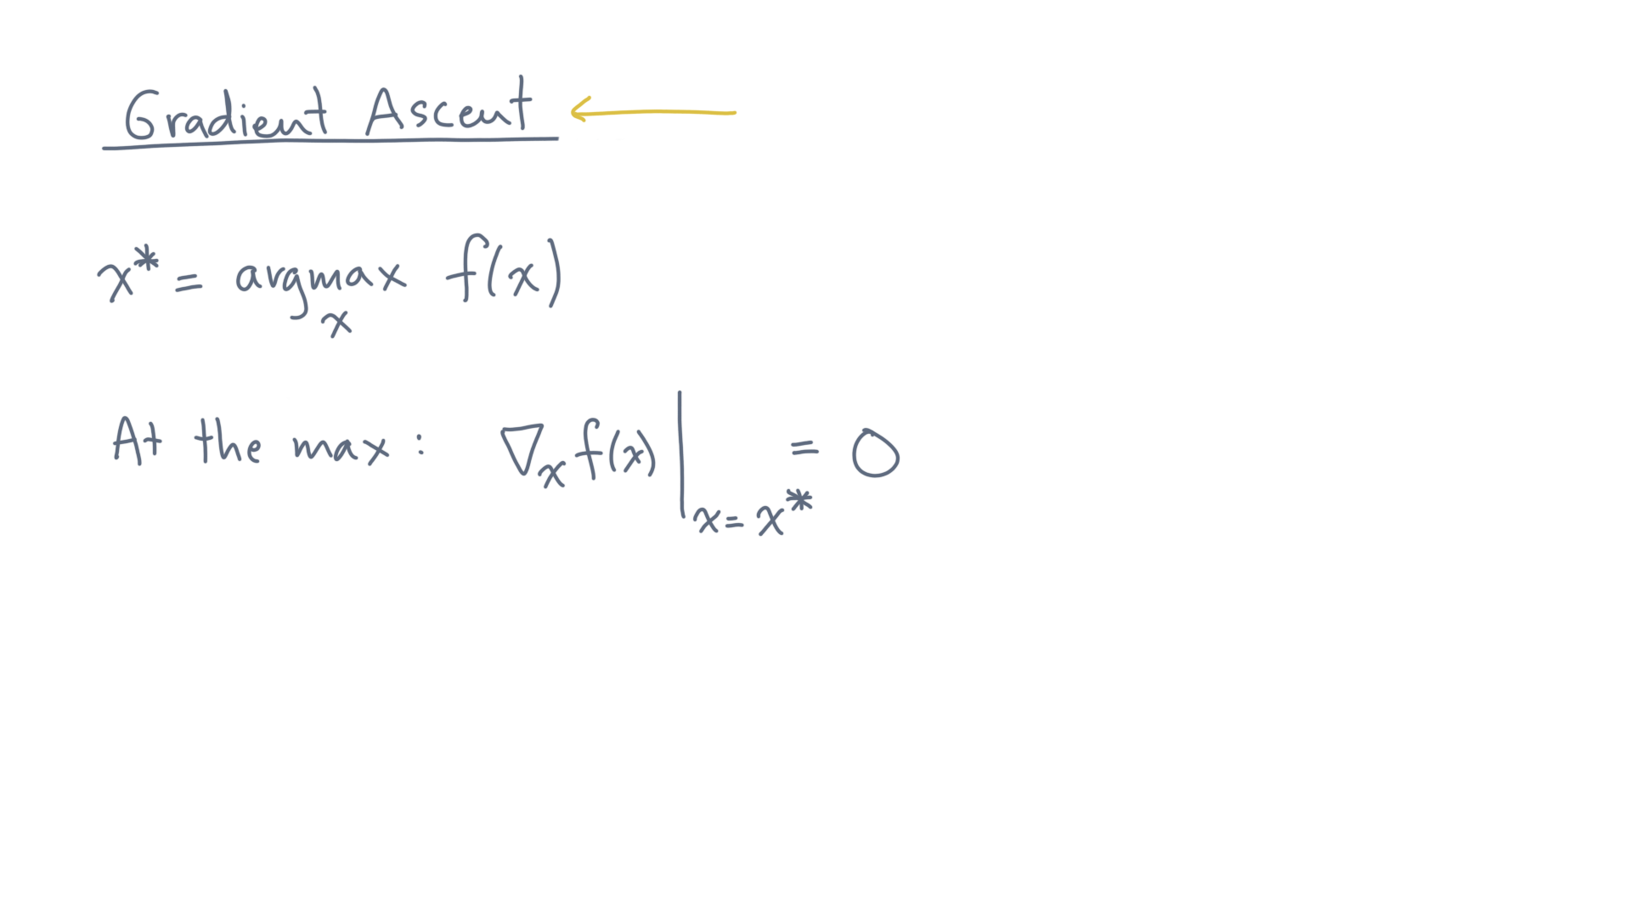
Notes:
“Gradient ascent” is probably the simplest such technique, so let’s see how that works.

Slide 13
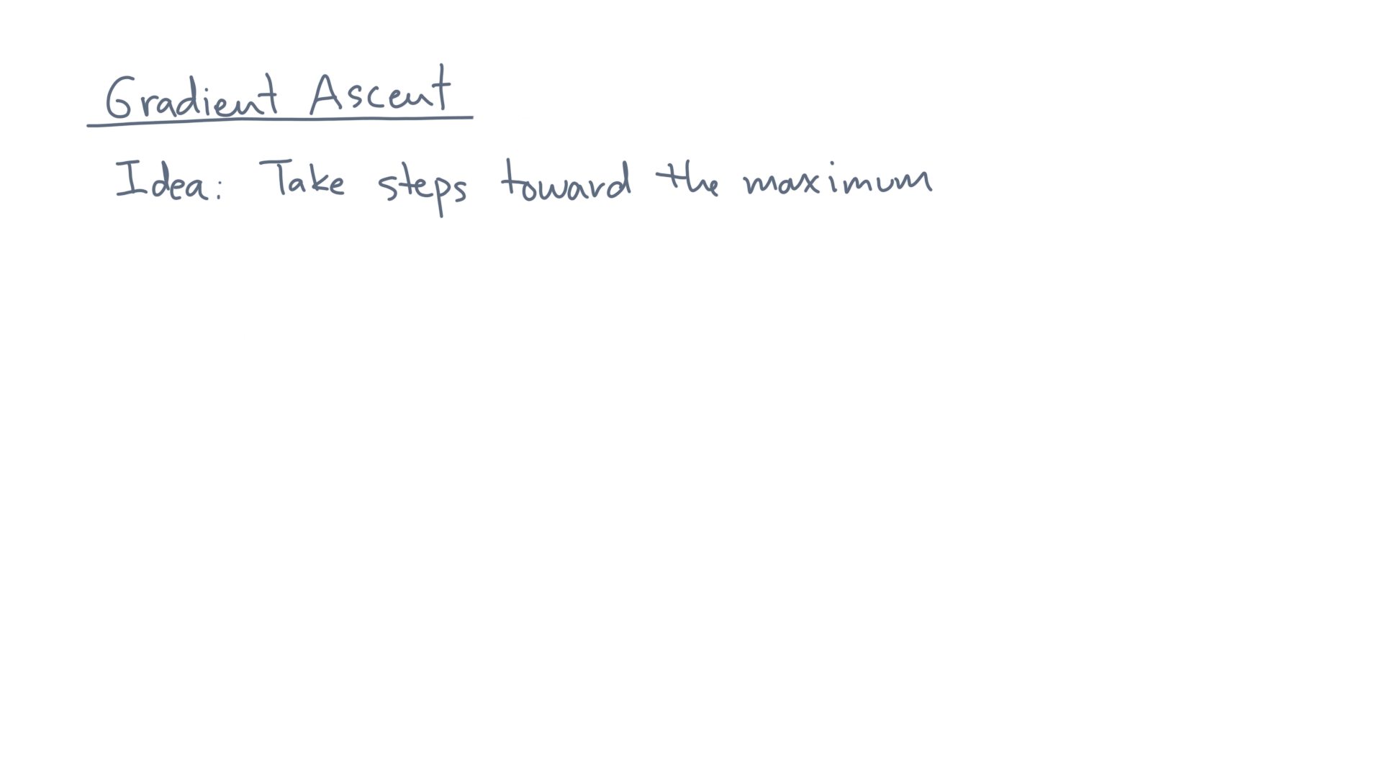
Notes:
Here’s the basic idea.
Start somewhere and take steps *upward*, *toward* the maximum

Slide 14
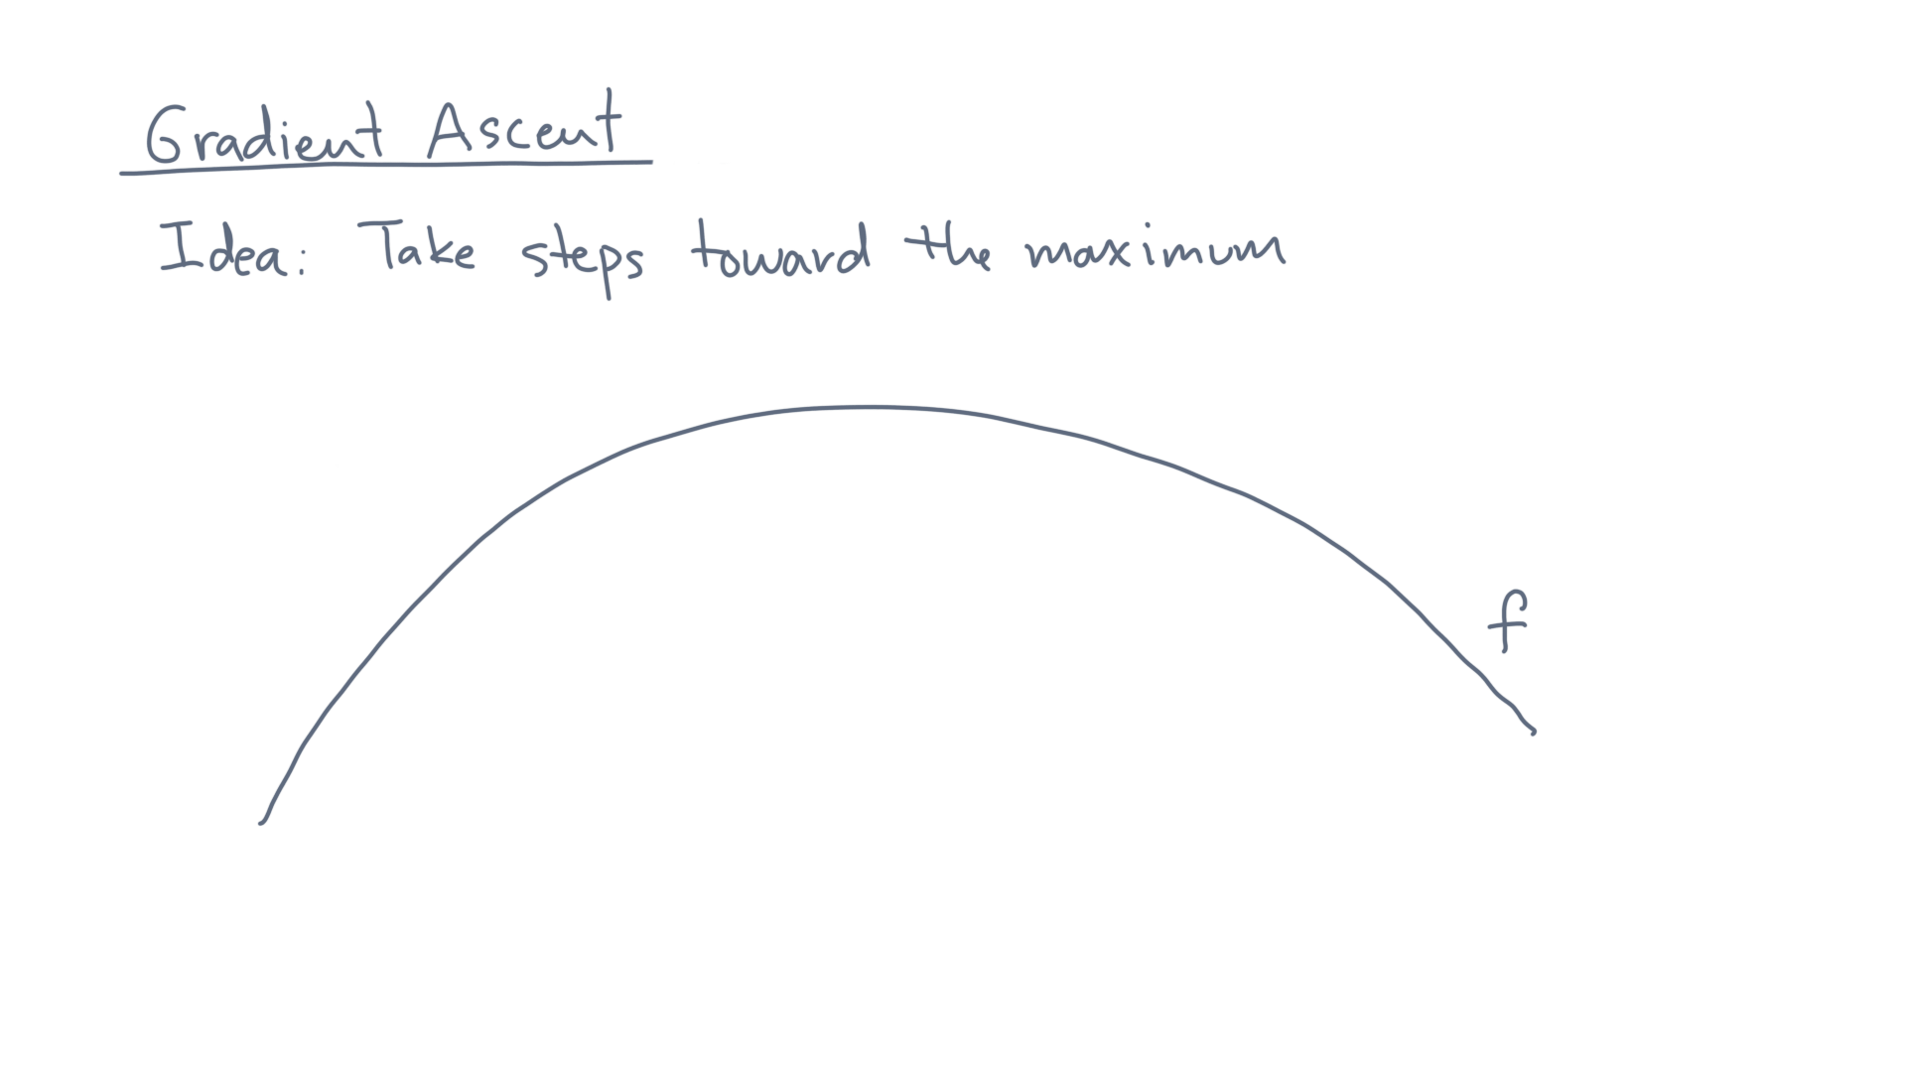
Notes:
For instance, suppose this is the function, f(x).

Slide 15
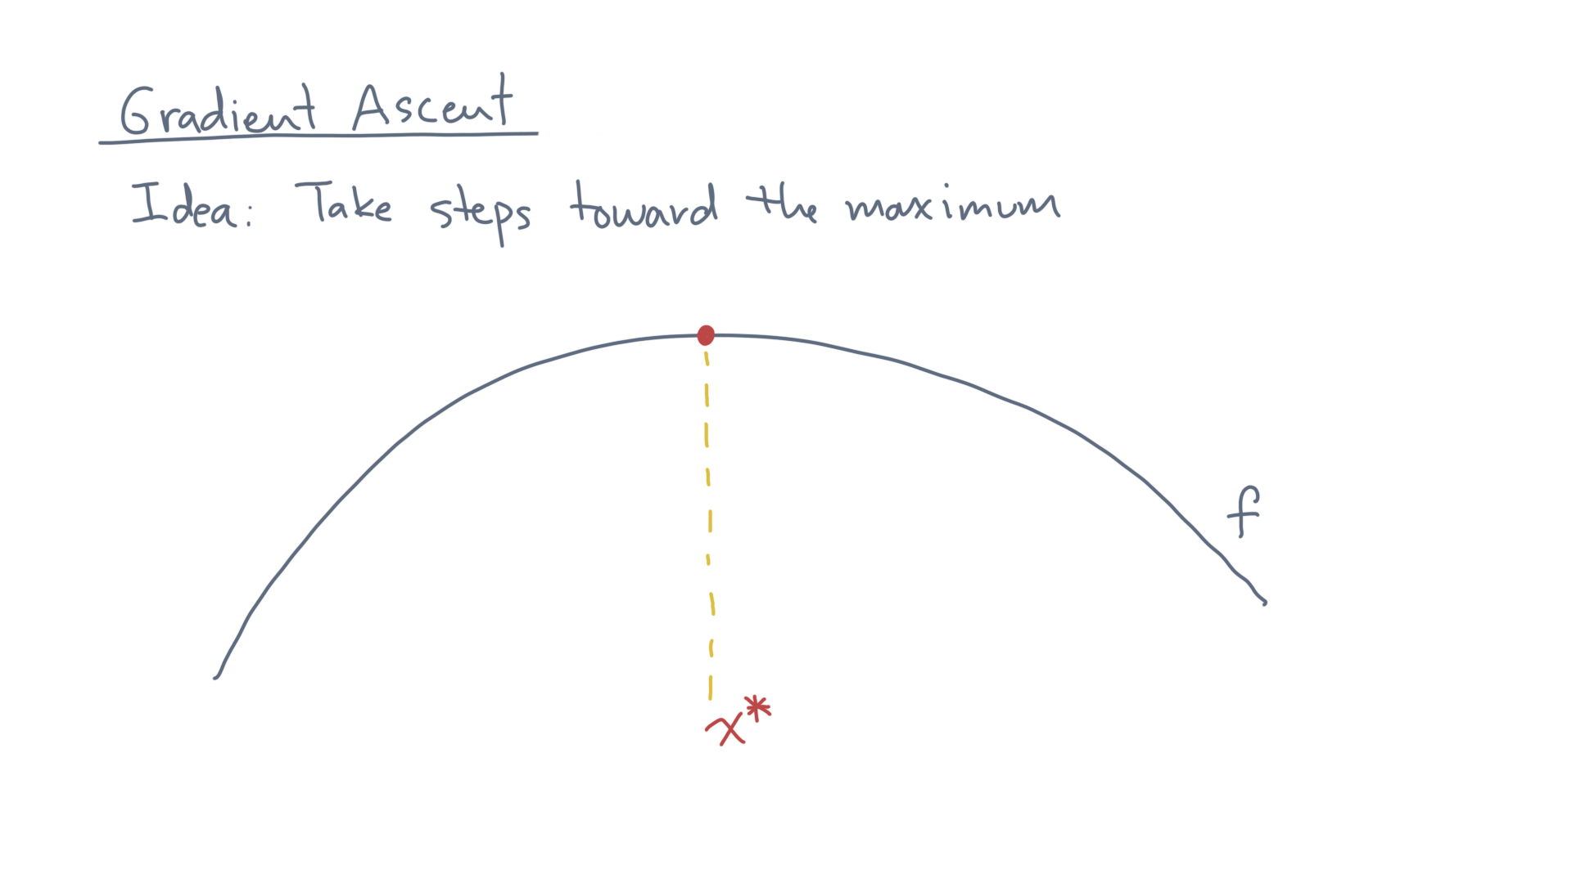
Notes:
You are trying to find the location of its maximum value, x-star.

Slide 16
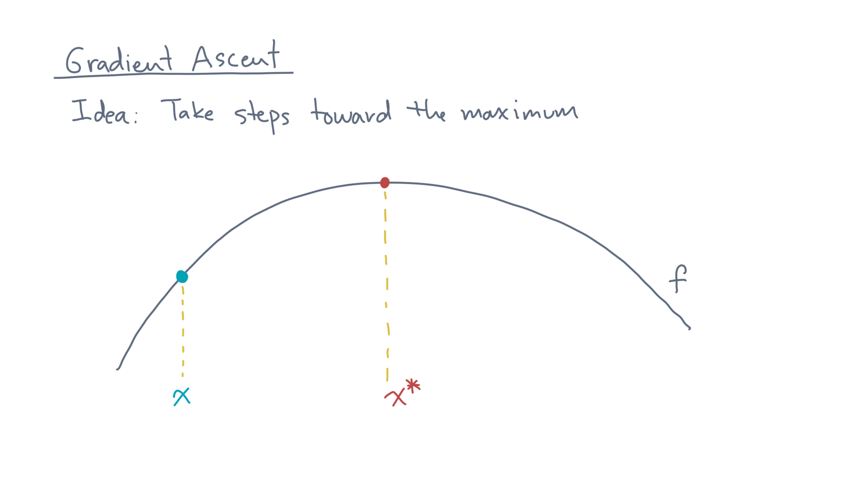
Notes:
Let’s say you start here, at some initial guess, x.
Now compute the derivative of f at this point.

Slide 17
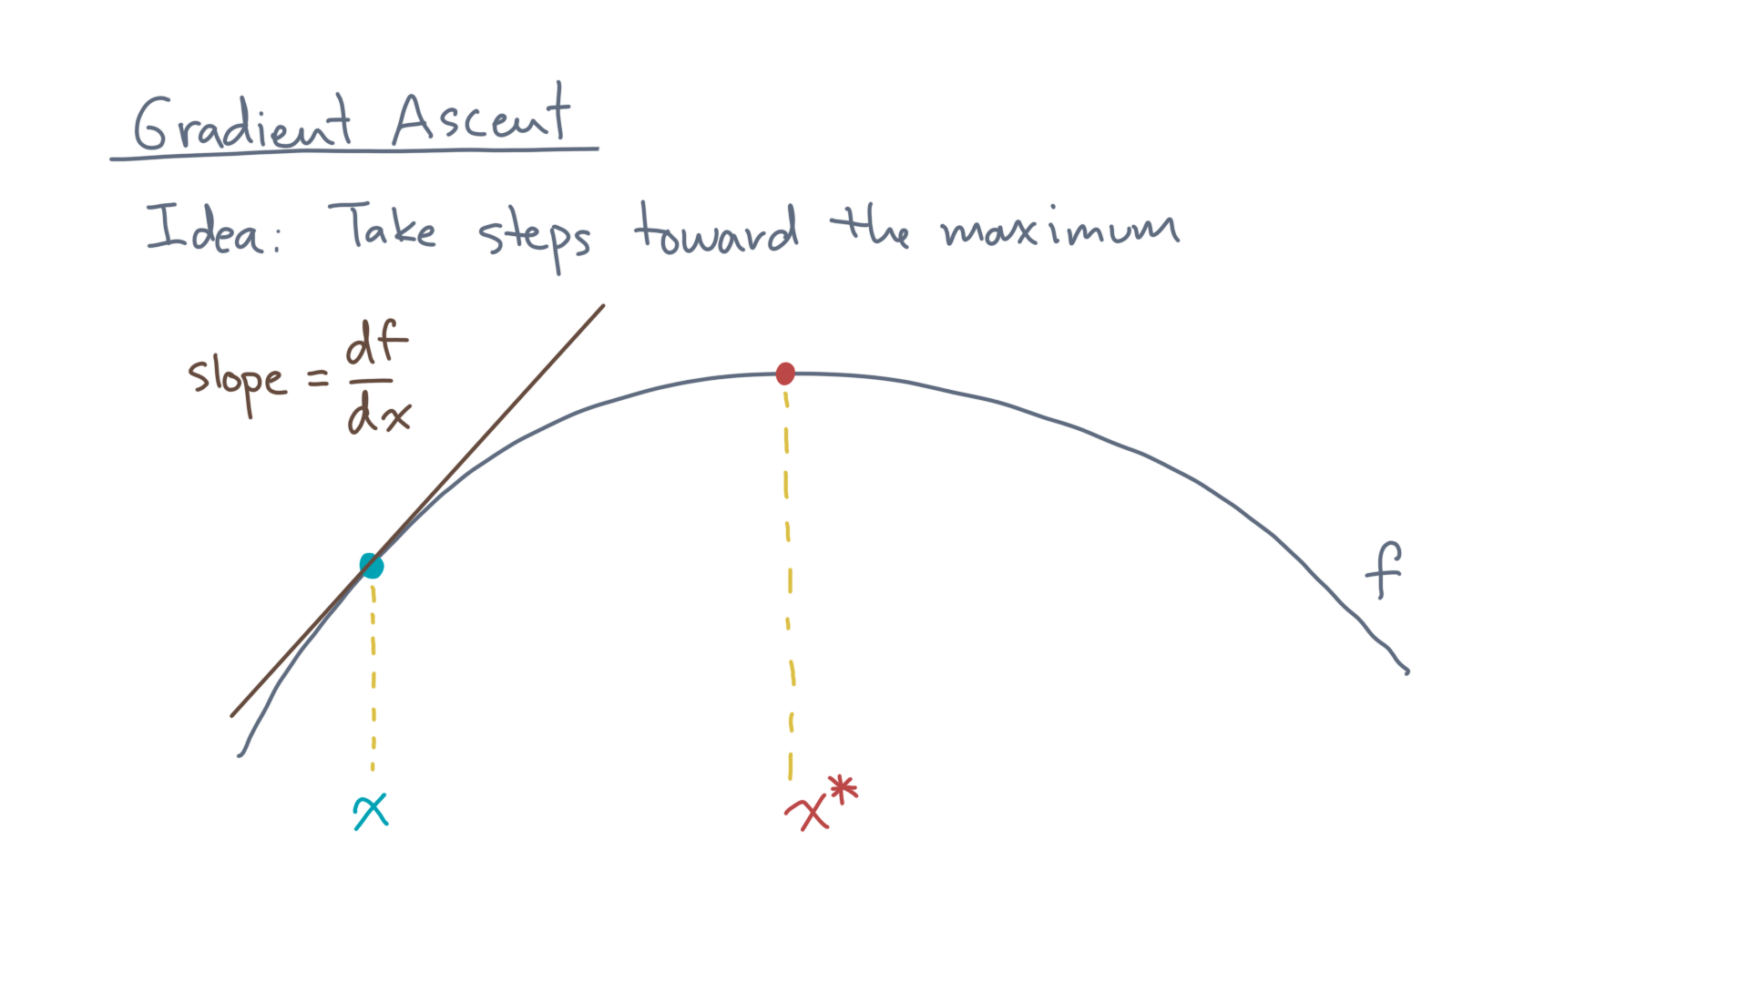
Notes:
Remember that the first derivative measures the slope of the function at this point.

Slide 18
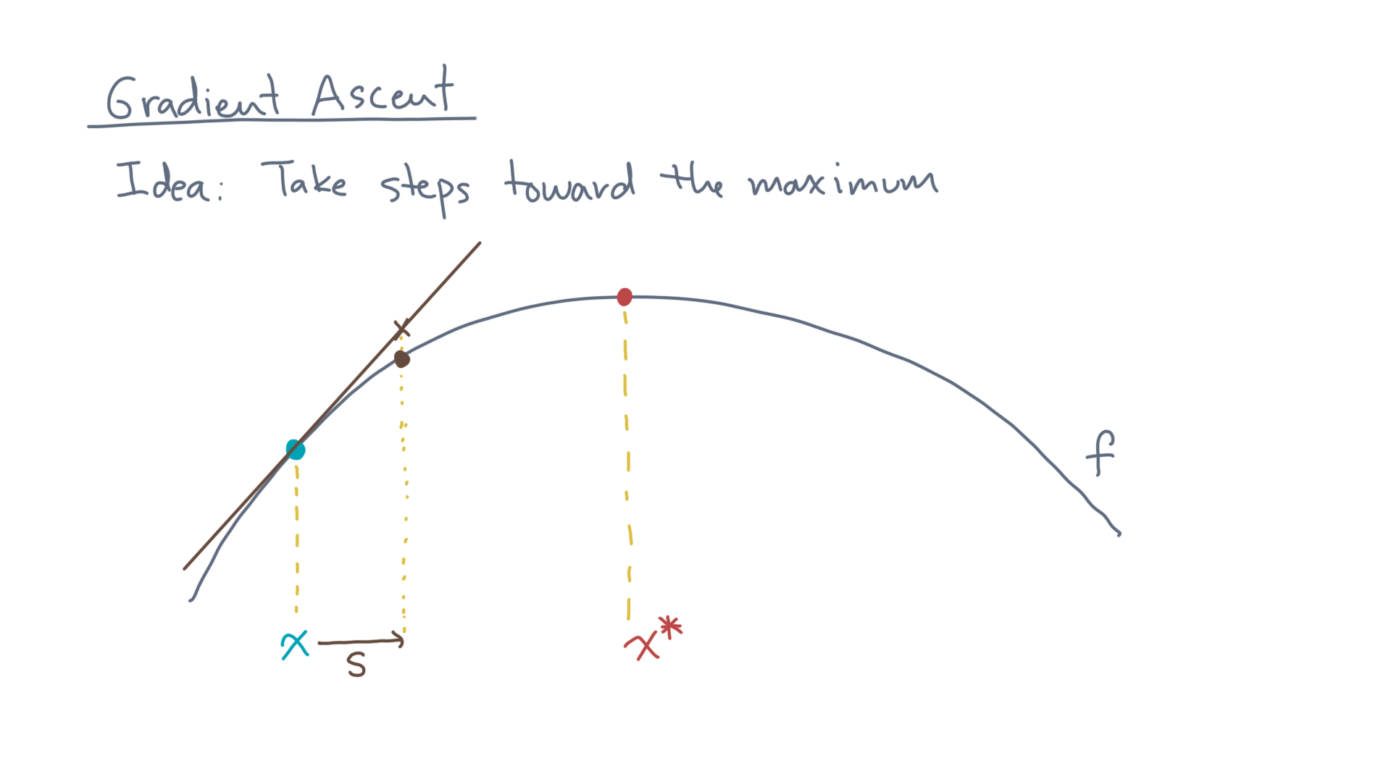
Notes:
So if you want to go “upwards” along f, the slope tells you which way to go!
In this case, it says you should move from “x” to “x plus s,” where s is some direction.

Slide 19
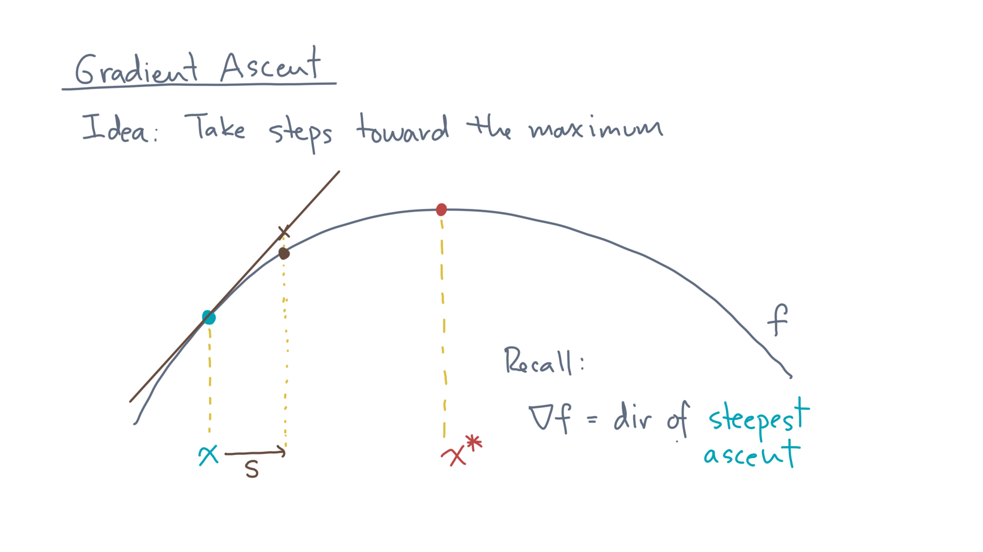
Notes:
You should also remember what the gradient does in higher dimensions:
It points in the direction of steepest ascent!

Slide 20
Notes:
At this point, you just repeat from the new position:

Slide 21
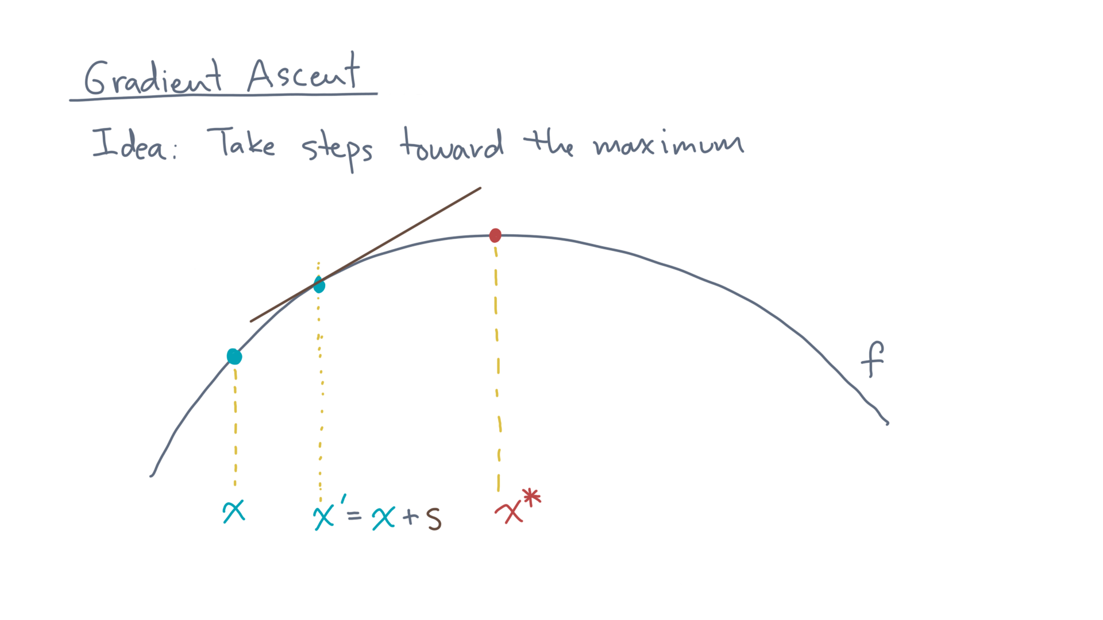
Notes:
That is, move to x-prime equals x plus s, compute the slope or gradient, and move in the right direction.

Slide 22
Notes:
So that’s the intuitive idea.
Let’s make it more precise.

Slide 23
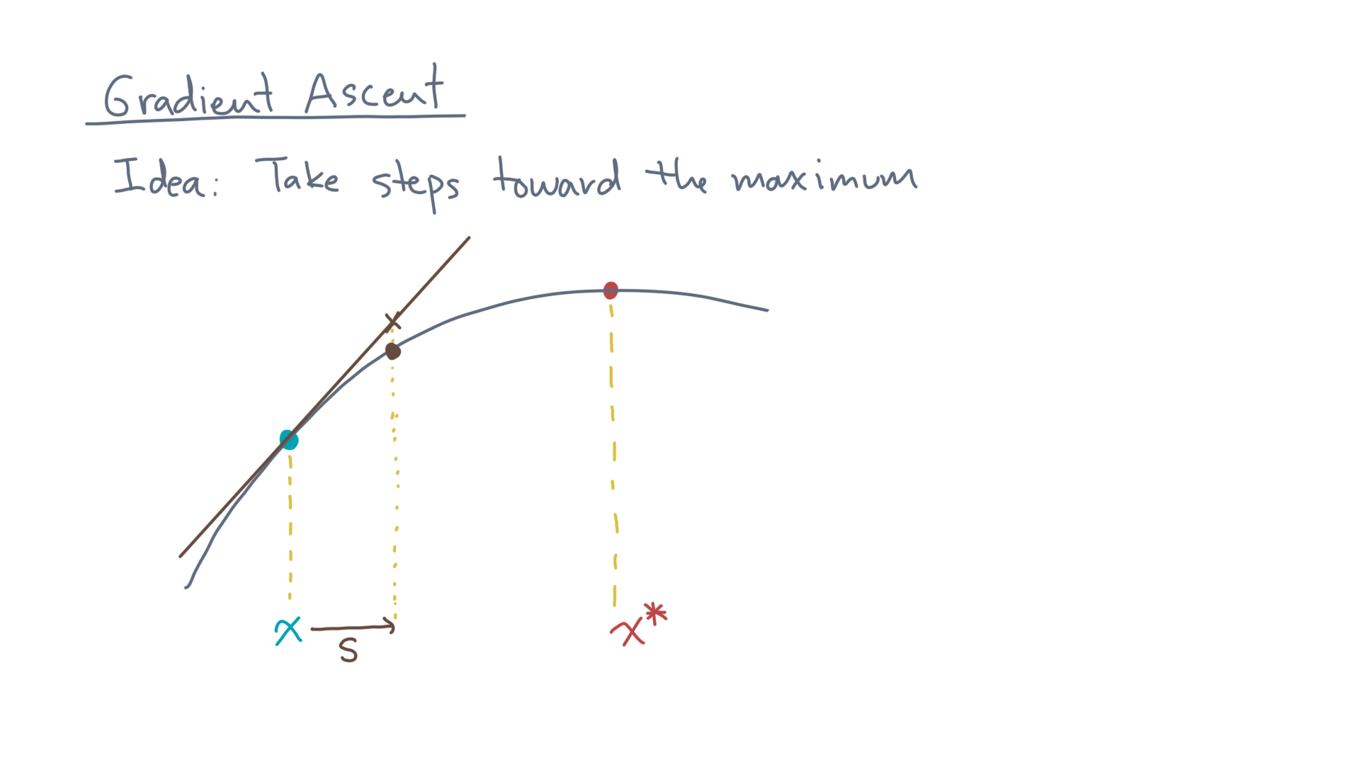
Notes:
Start with the idea of “taking a step.”

Slide 24
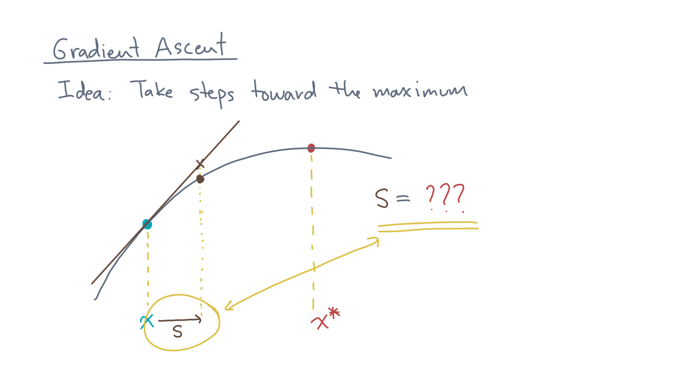
Notes:
How should we choose “s”?

Slide 25
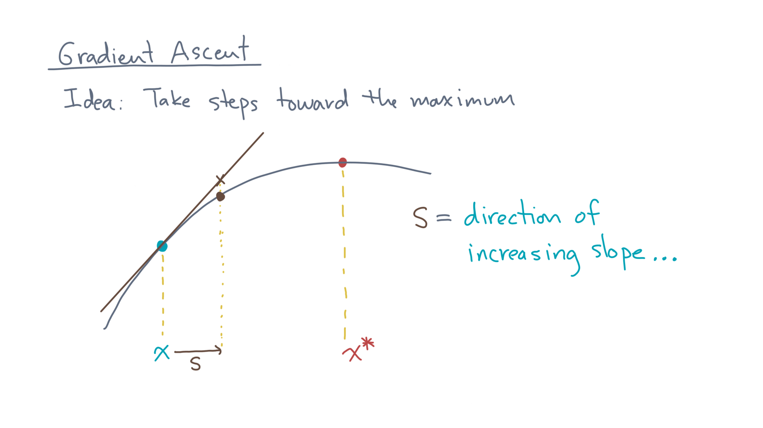
Notes:
You’d like to go in the *direction* of increasing slope…

Slide 26
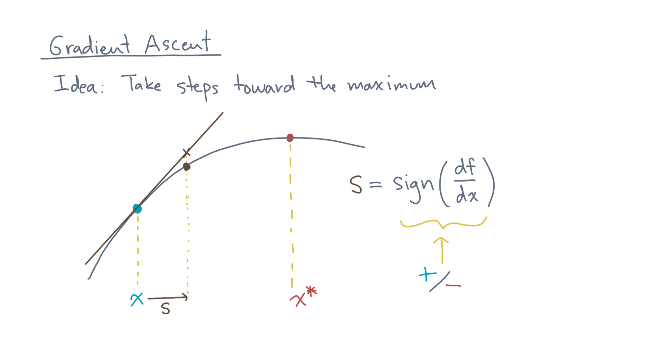
Notes:
In one dimension, that’s just the *sign* of the derivative.

Slide 27
Notes:
In other words, from the guess “x” you’ll either go to the right if the slope is positive, or to the left if the slope is negative.

Slide 28
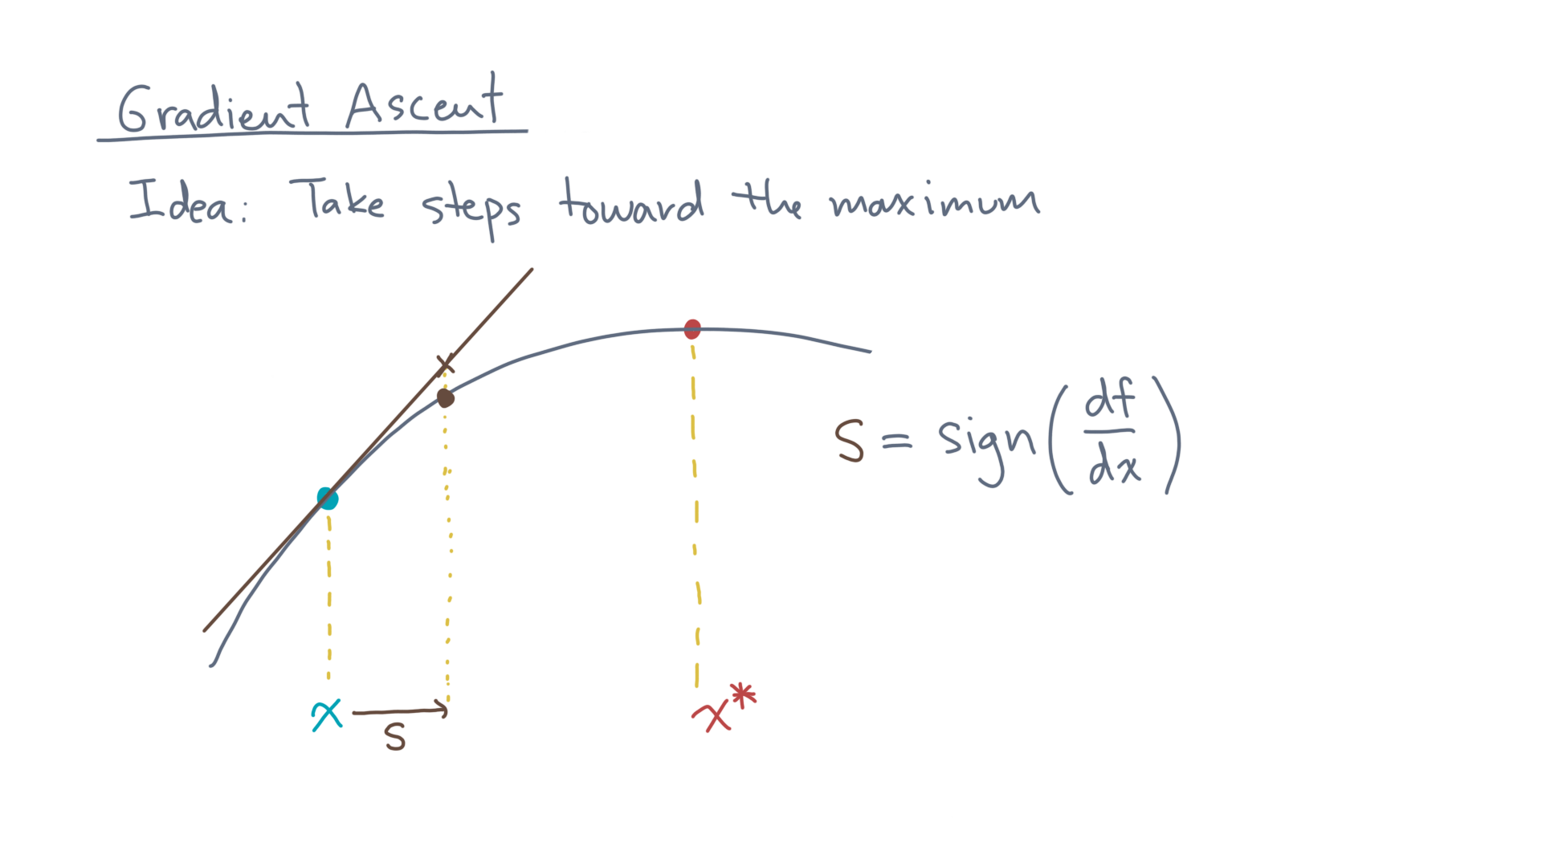
Notes:
But you’re not done yet.
After all, how *large* should the step be?

Slide 29
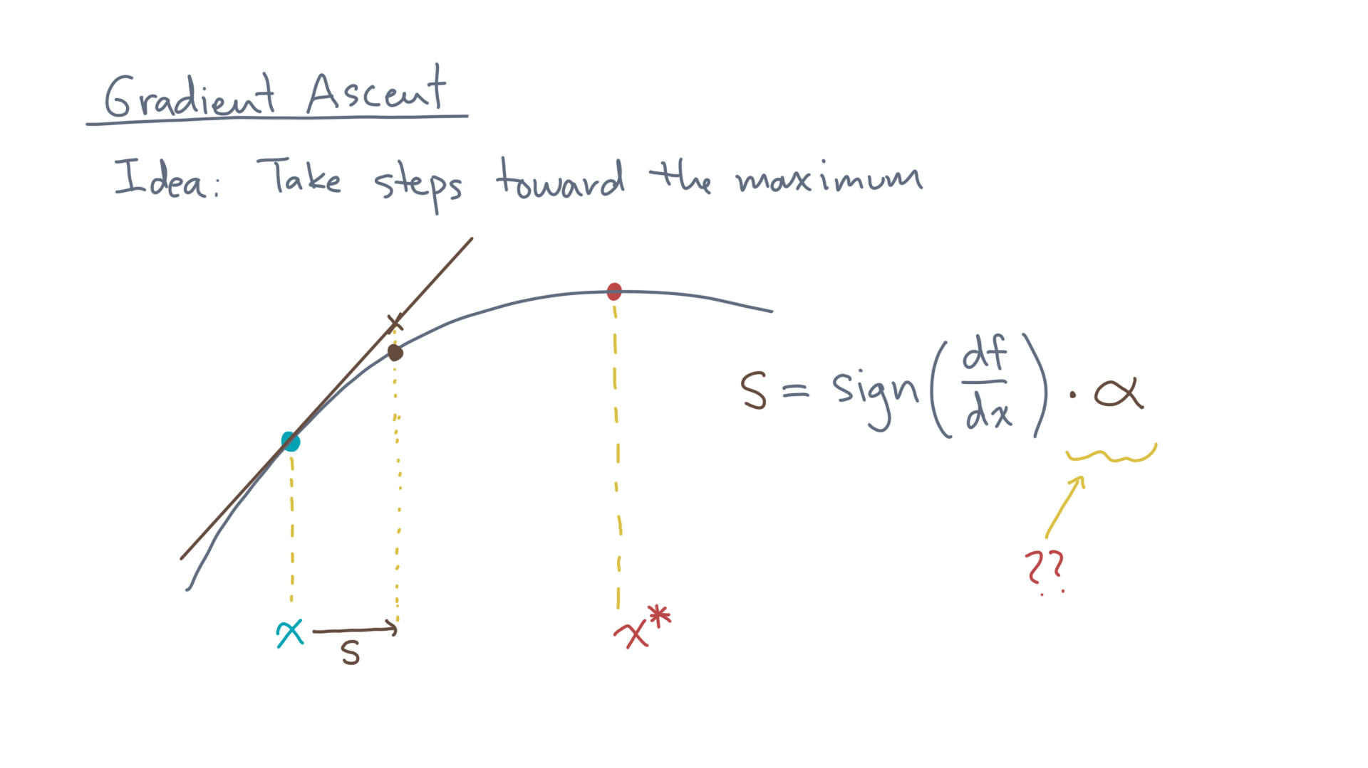
Notes:
Let’s introduce a scaling factor, alpha, for the size of the step.

Slide 30
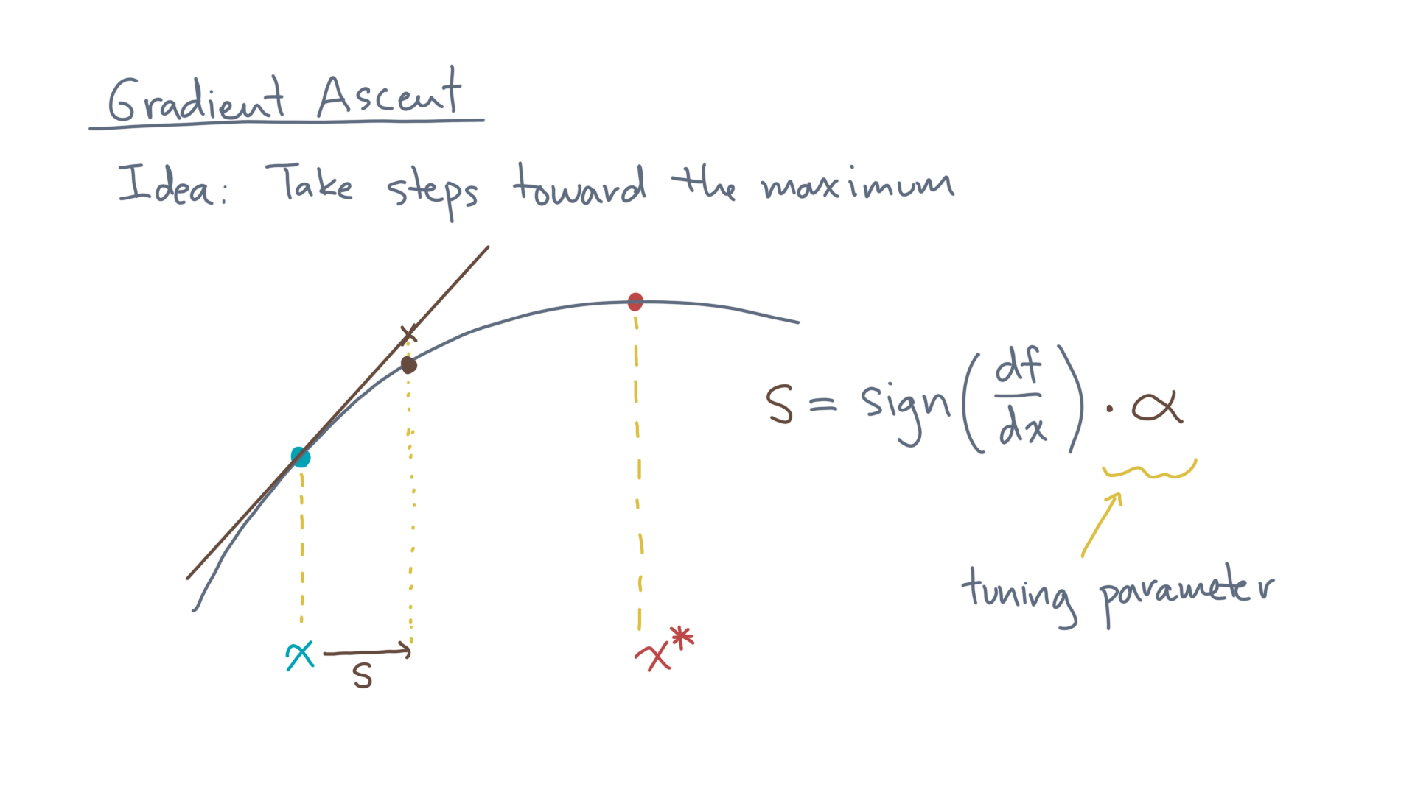
Notes:
There are a number of sophisticated schemes for selecting alpha, but in this gentle introduction to gradient ascent, let’s just take it to be a user-specified tuning parameter.

Slide 31

Notes:
And let’s always choose it to be positive, since it’s a scaling factor.

Slide 32
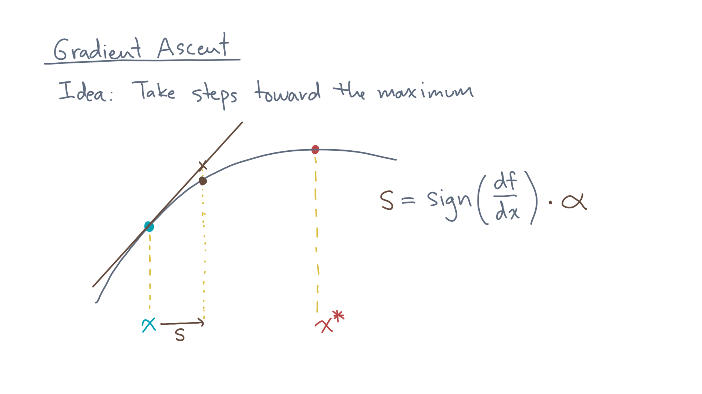
Notes:
So why should this work?

Slide 33
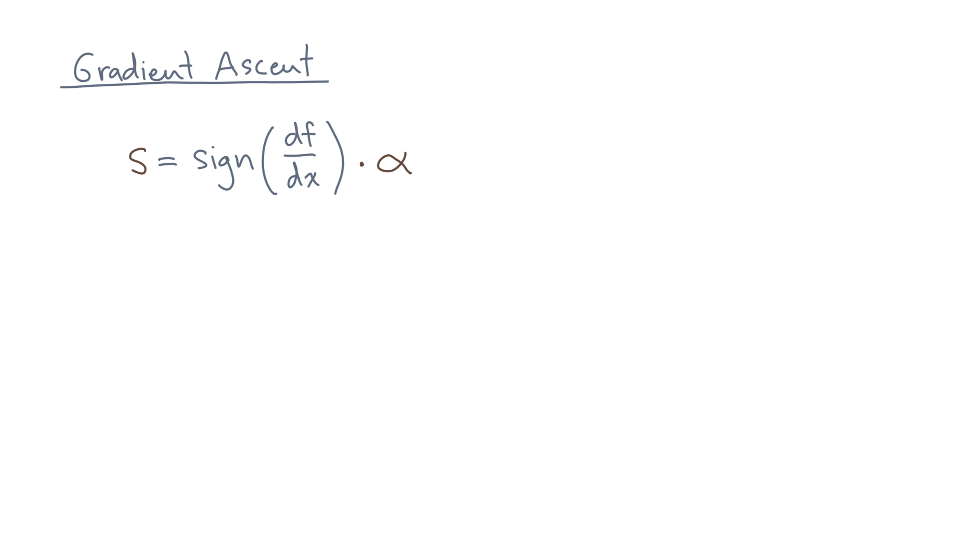
Notes:
Let’s start with the 1-D case first.

Slide 34
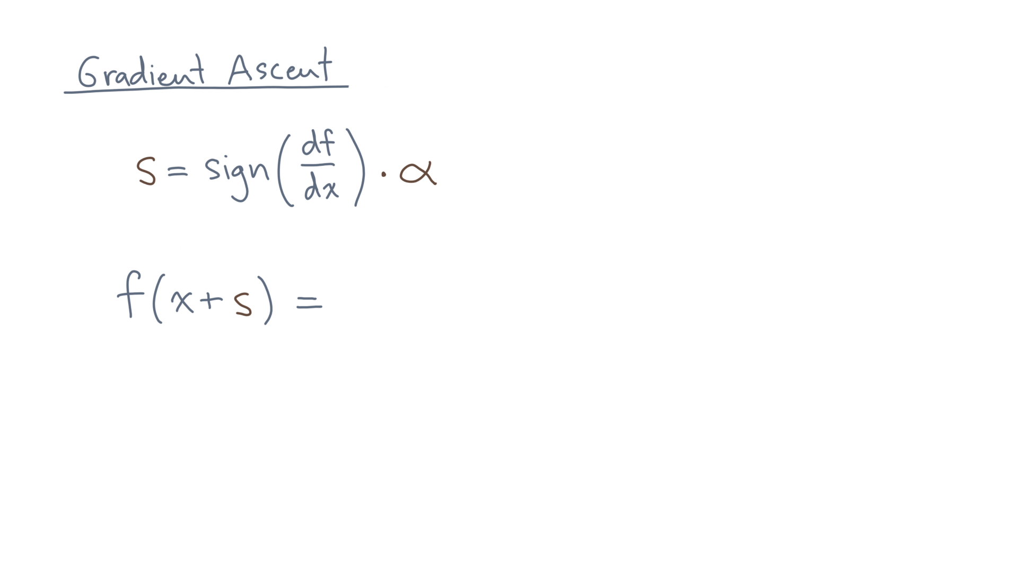
Notes:
What happens when we move from “x” to “x plus s”?

Slide 35
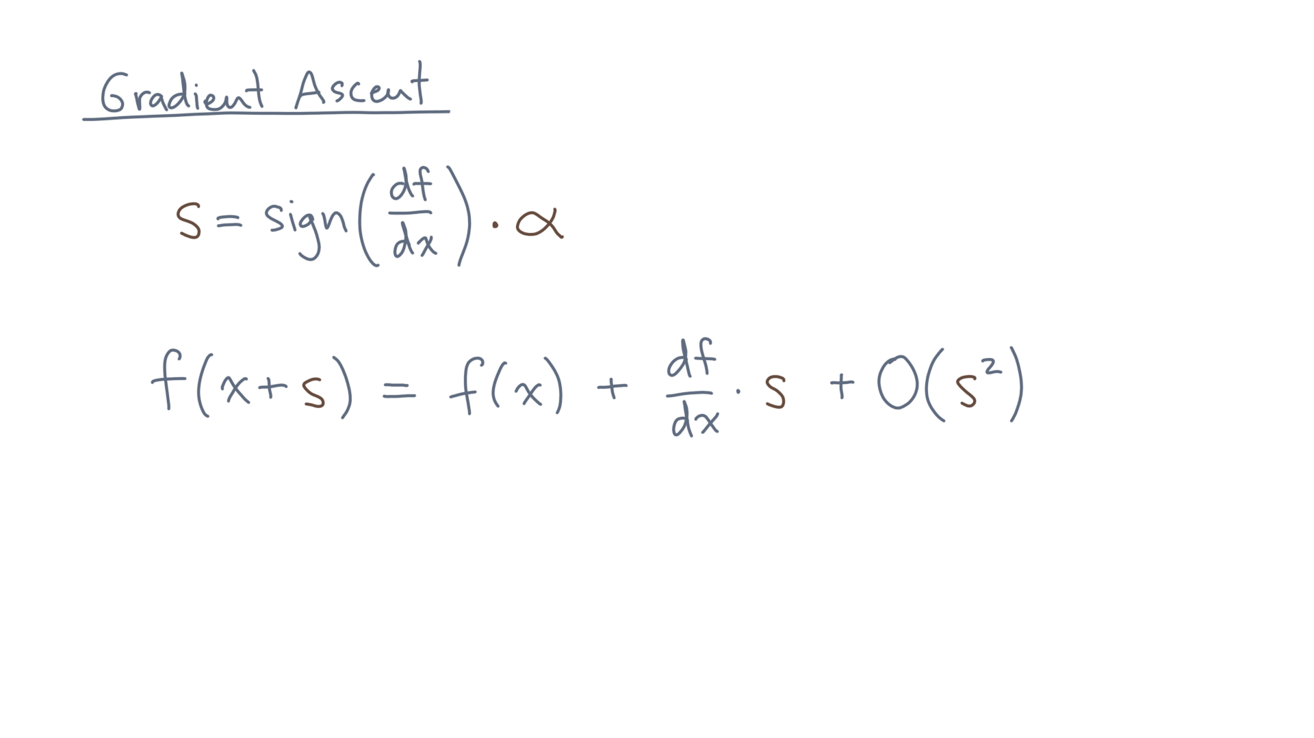
Notes:
Now consider the Taylor expansion.

Slide 36
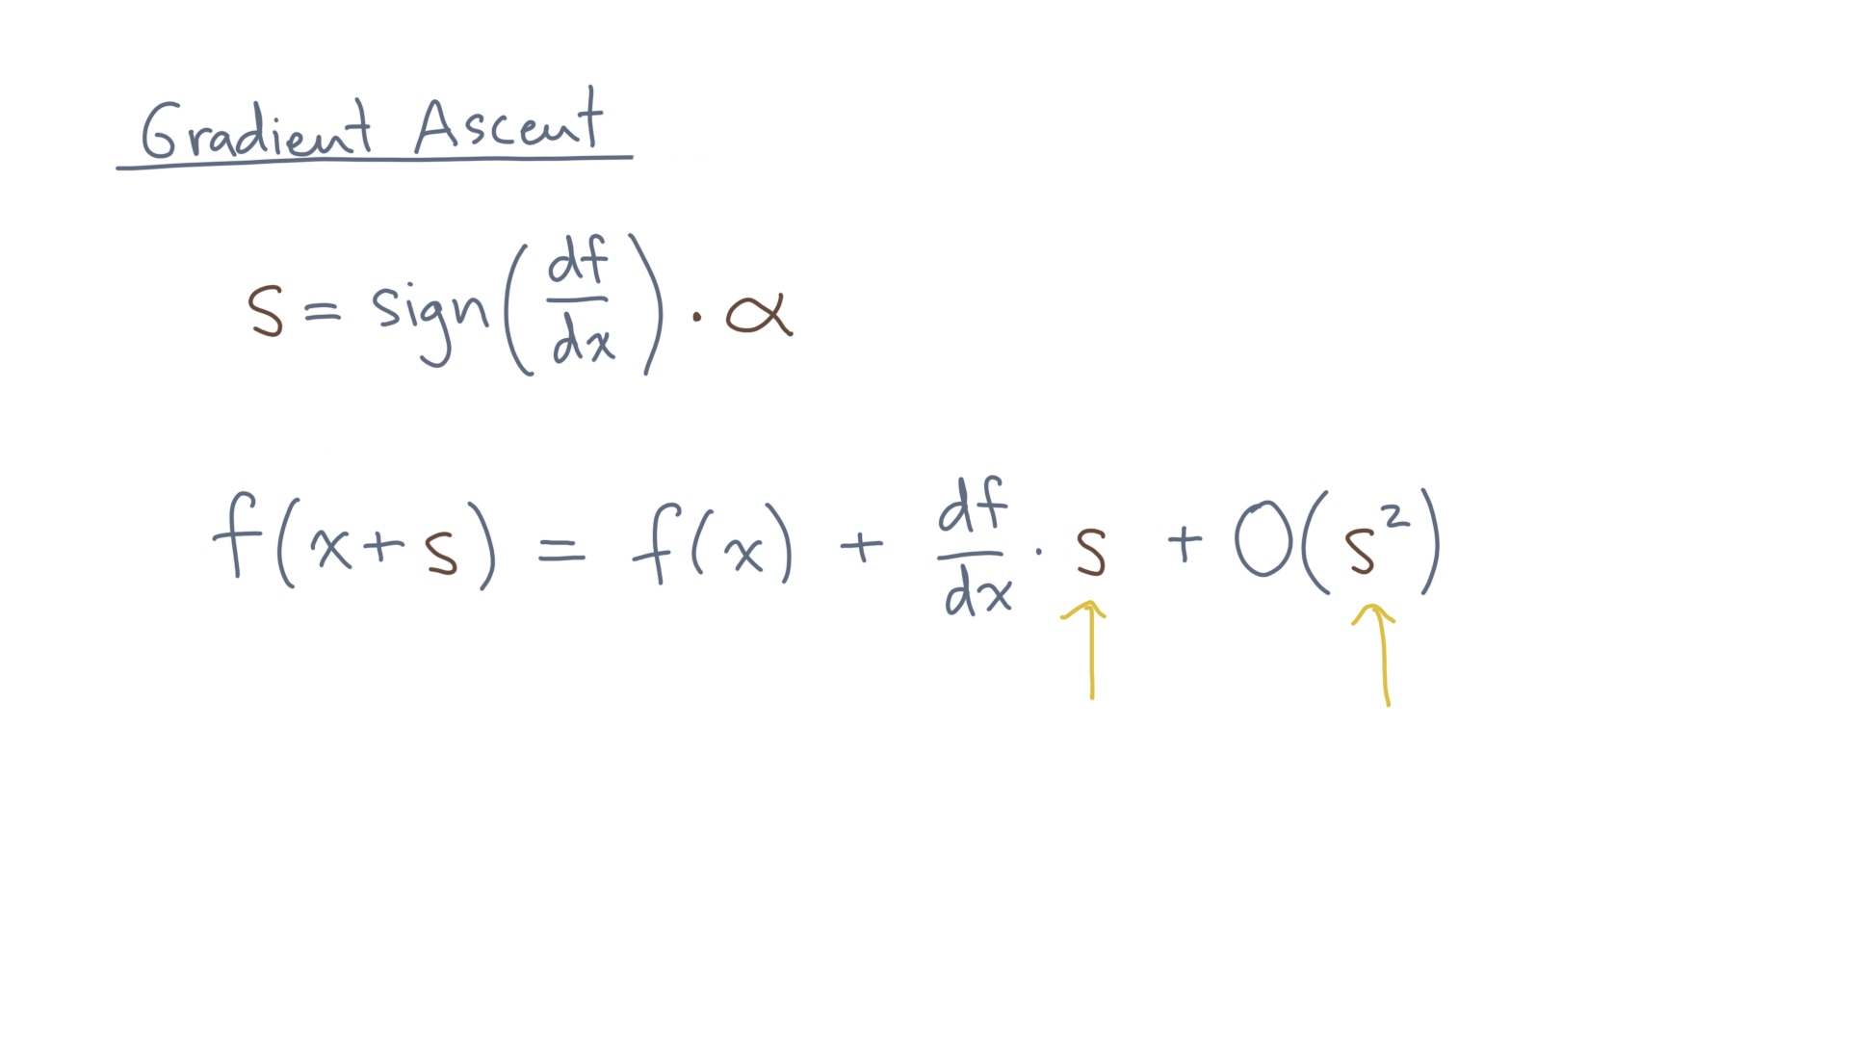
Notes:
If “s” is small enough, then “s-squared” will also be very small, and we can ignore it and any other higher-order terms in “s.”

Slide 37
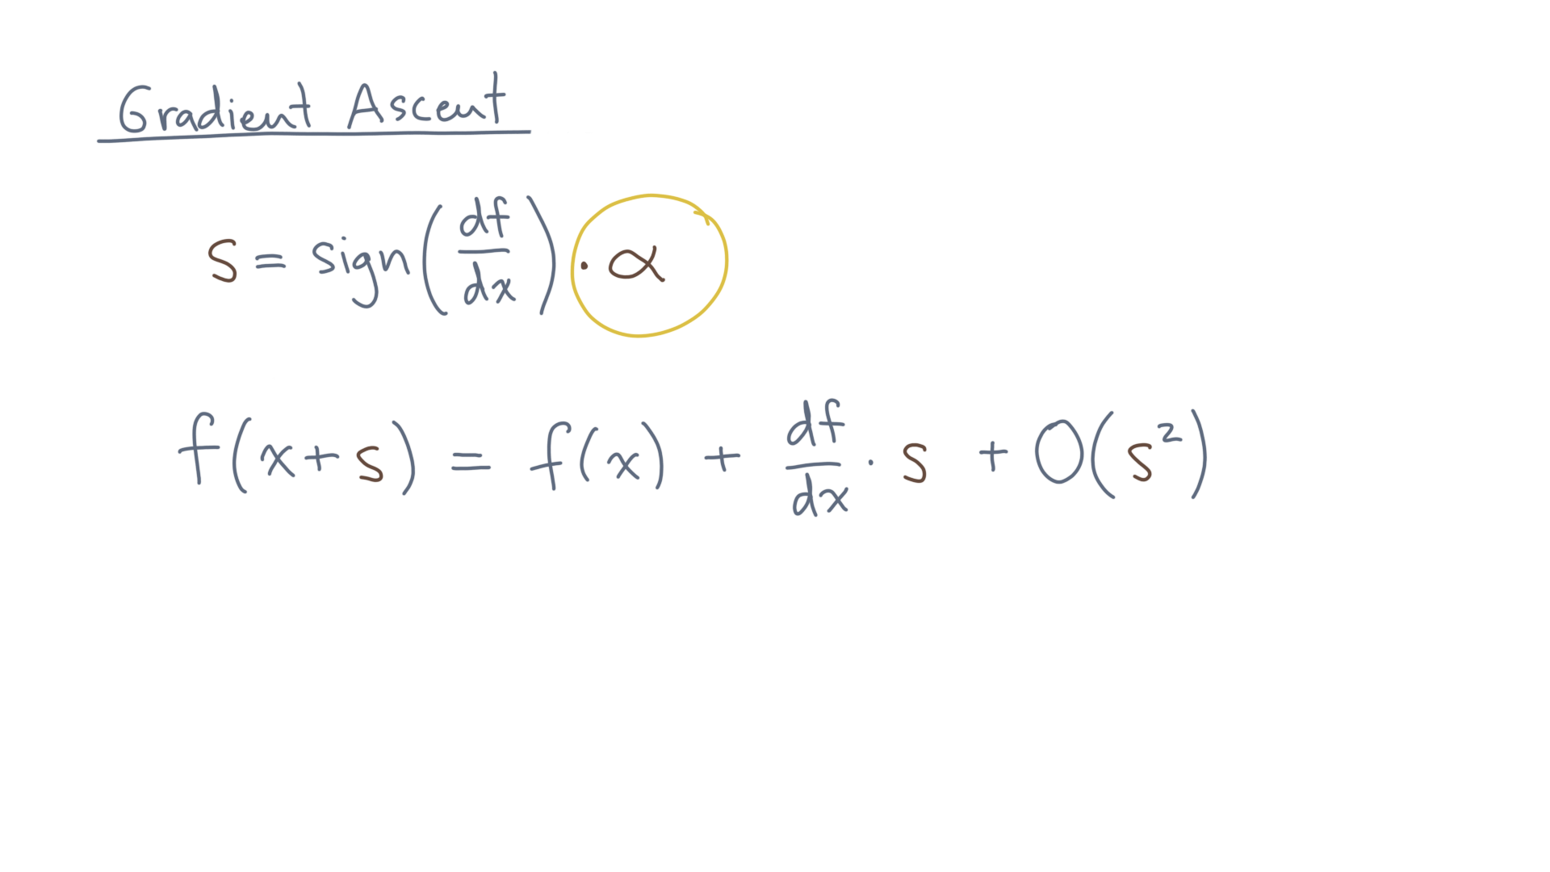
Notes:
Now as a practical matter, assuming “s” is small means “alpha” will need to be small as well, so just keep that in mind when implementing this scheme.

Slide 38
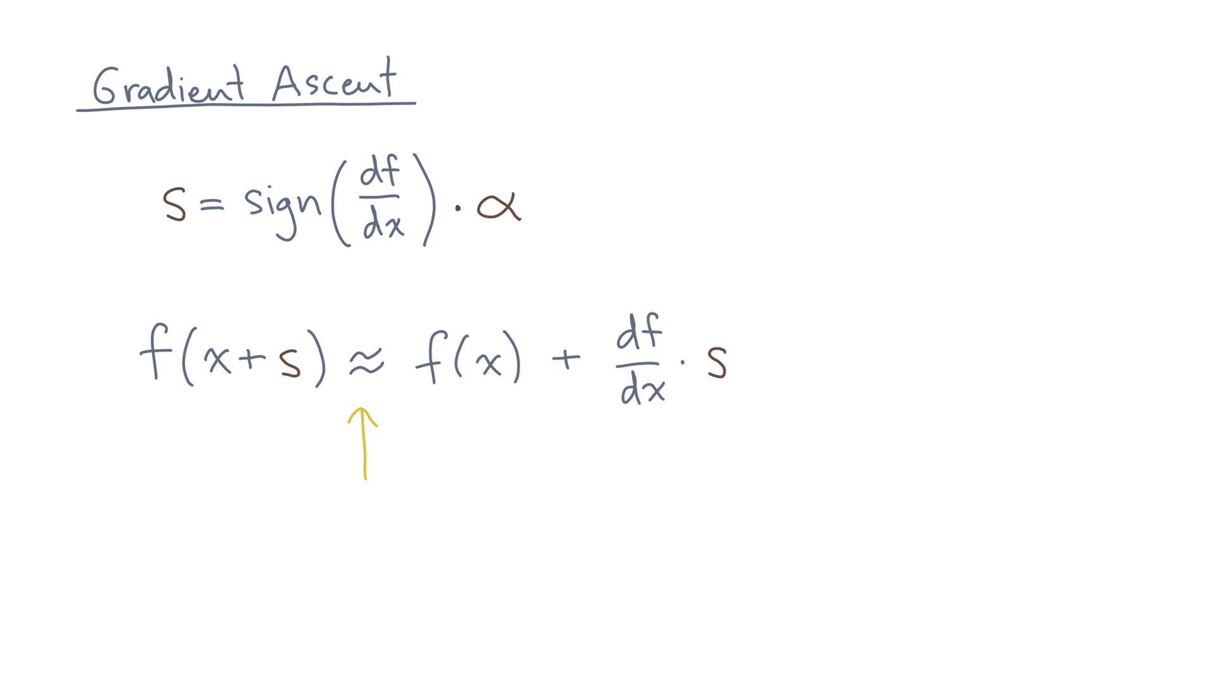
Notes:
Anyway, assuming a small “s”, then the value of the function at x plus s is approximately this expression:

Slide 39
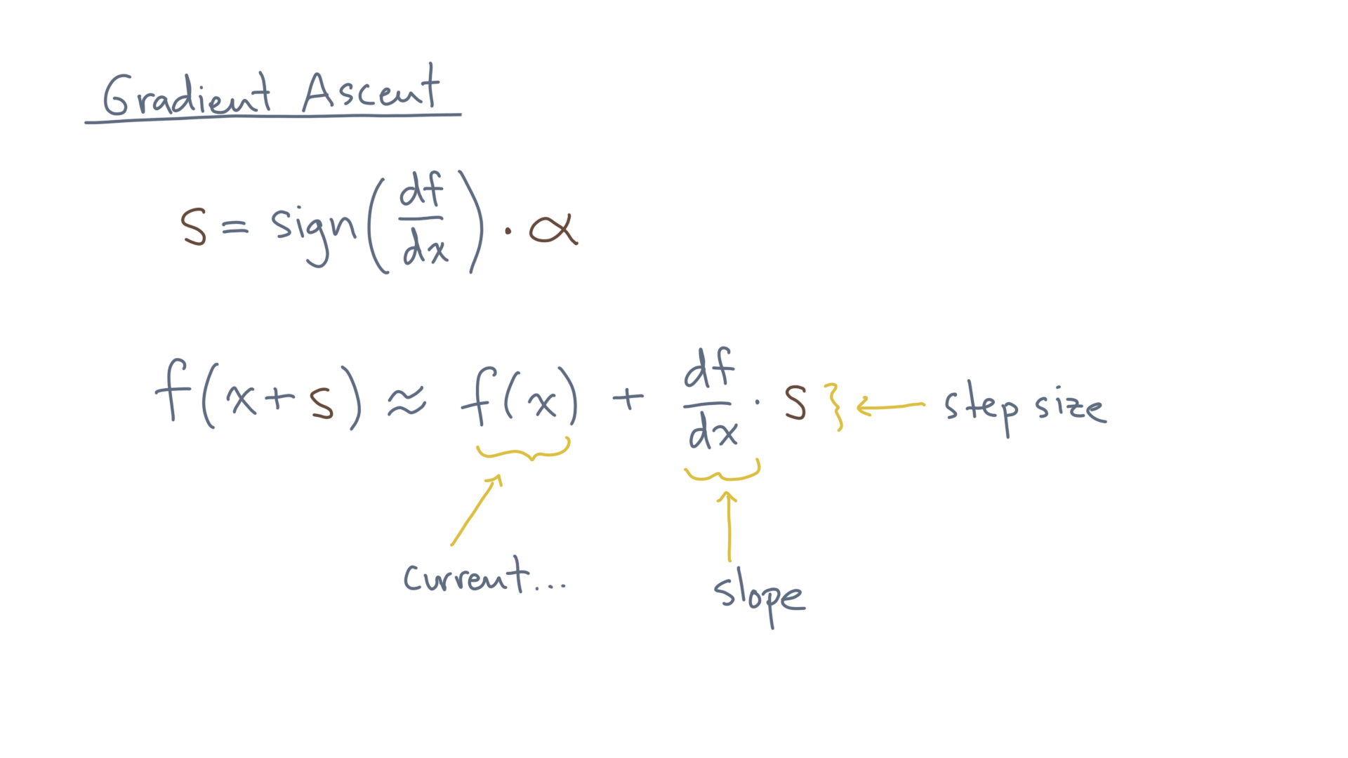
Notes:
The current value PLUS the slope TIMES the step size.
Let’s plug in the step size…

Slide 40
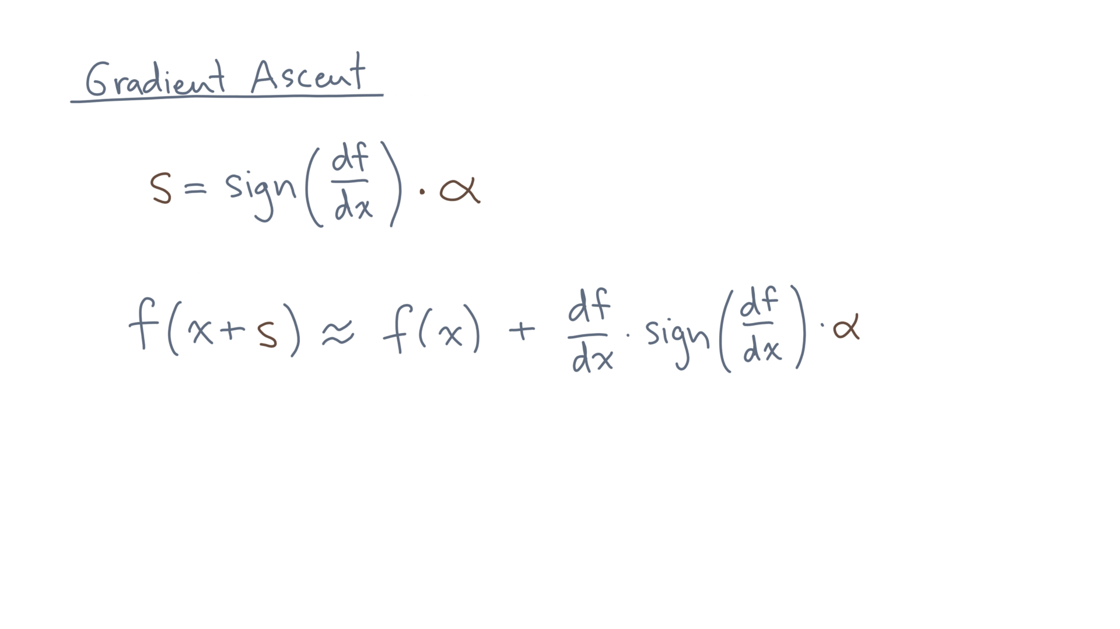
Notes:
Take a look at this first factor:

Slide 41
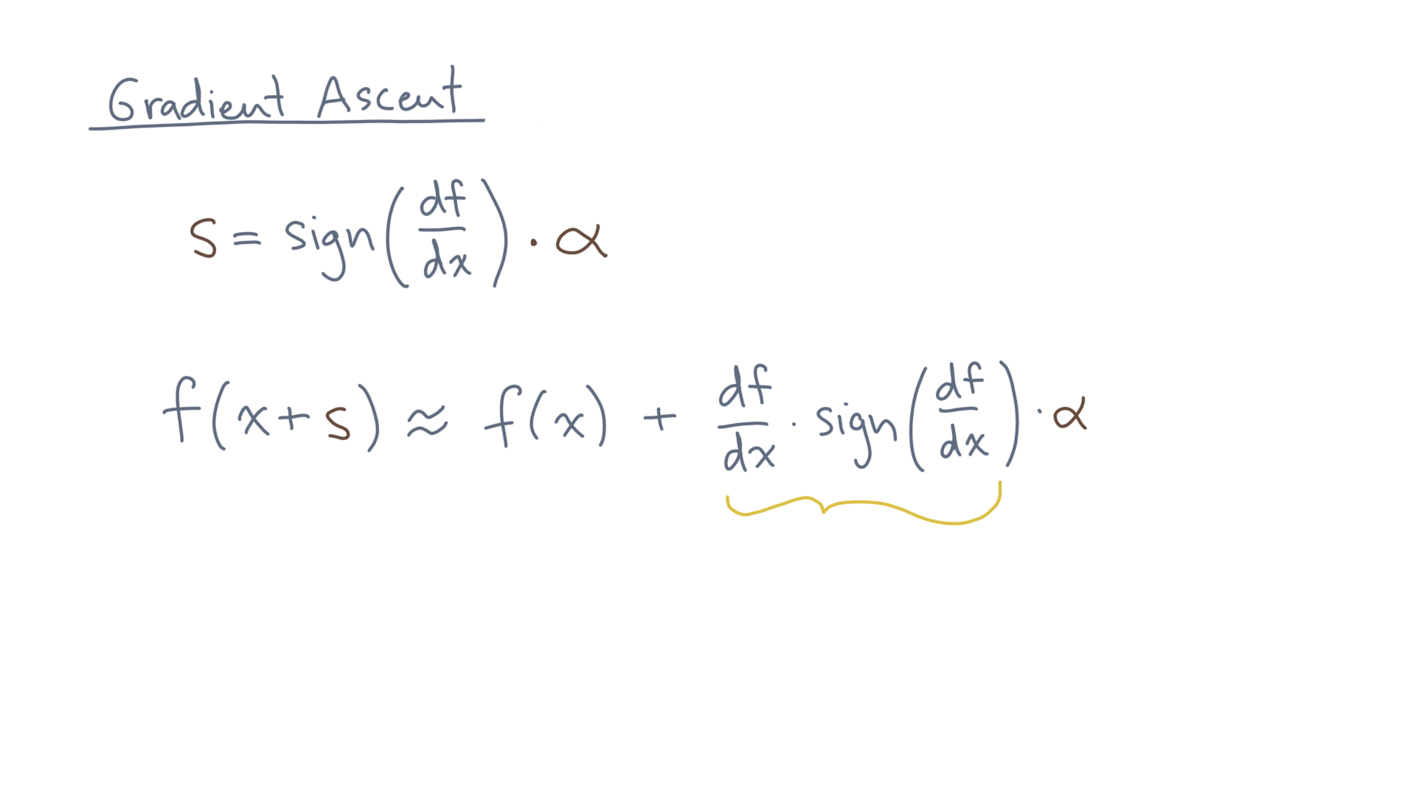
Notes:
What do you notice?

Slide 42
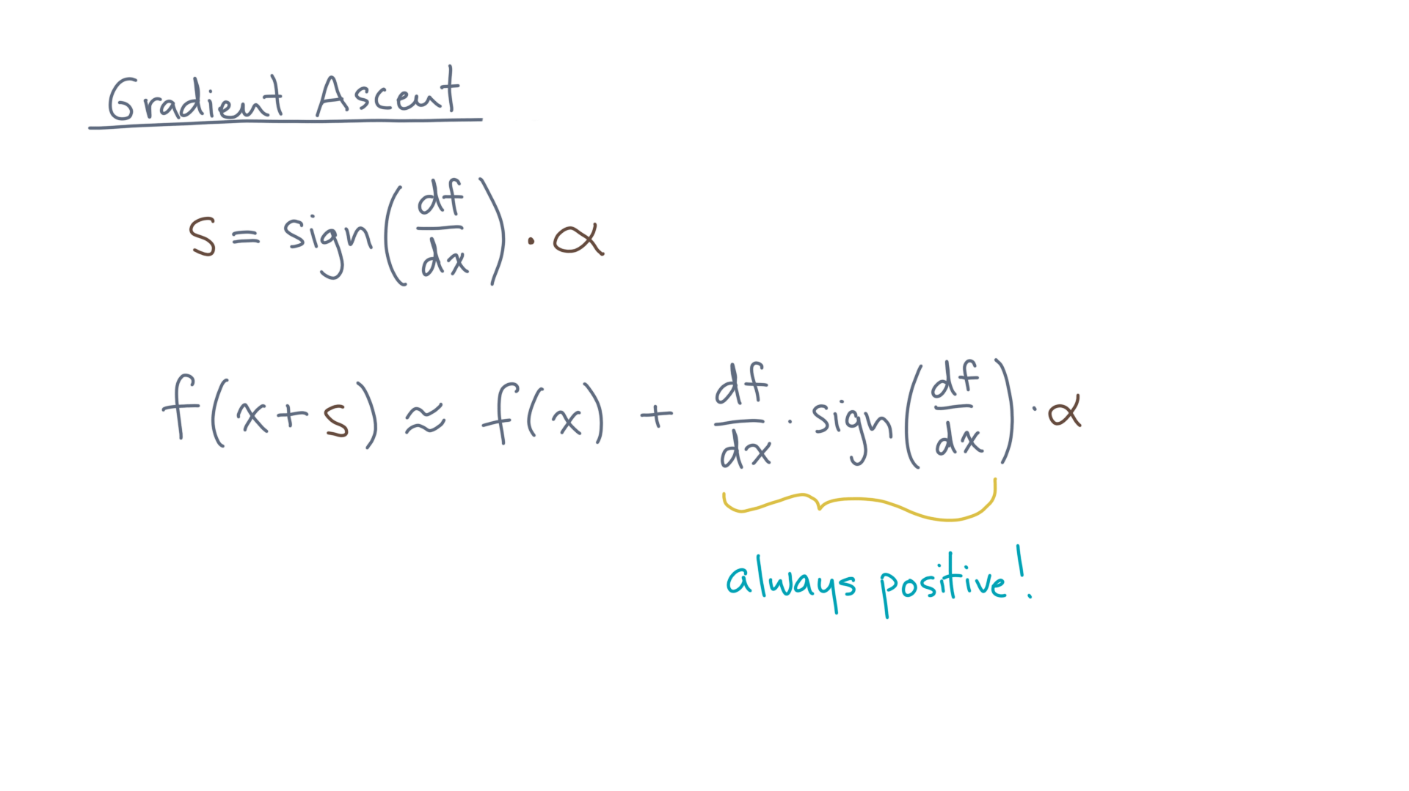
Notes:
That’s right – it’s always positive!

Slide 43
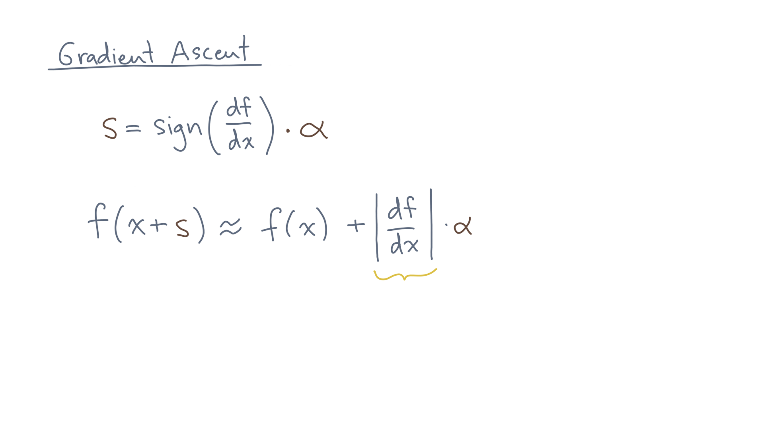
Notes:
In fact, it’s nothing more than the absolute value of the first derivative.

Slide 44
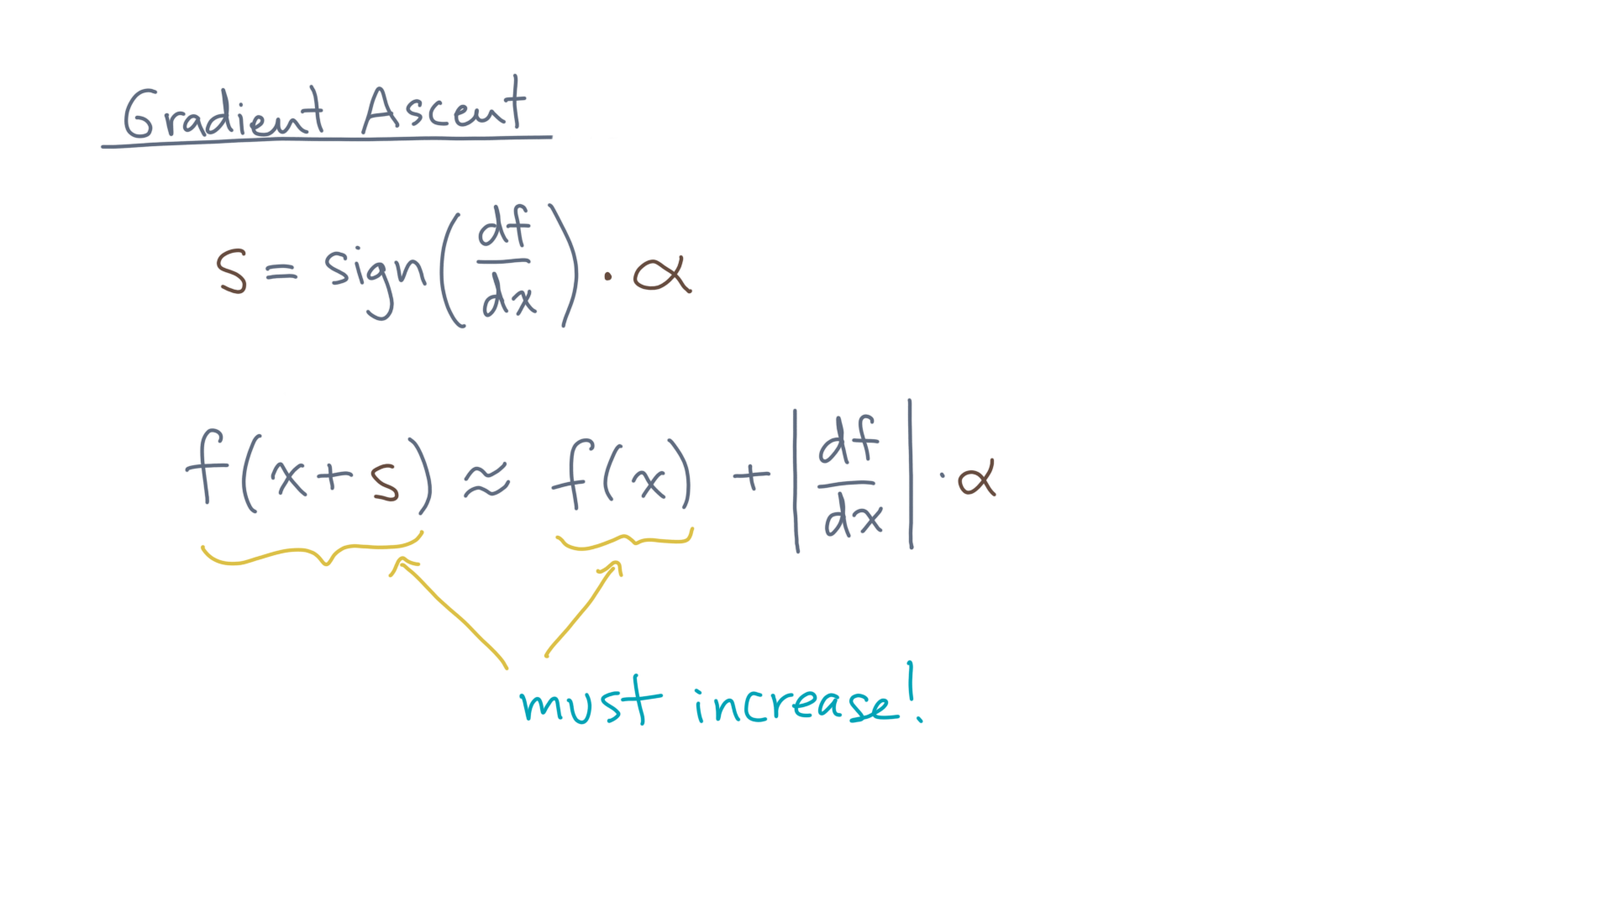
Notes:
Consequently, the value at this new point, x plus s, *must be higher* than its current value at x.

Slide 45
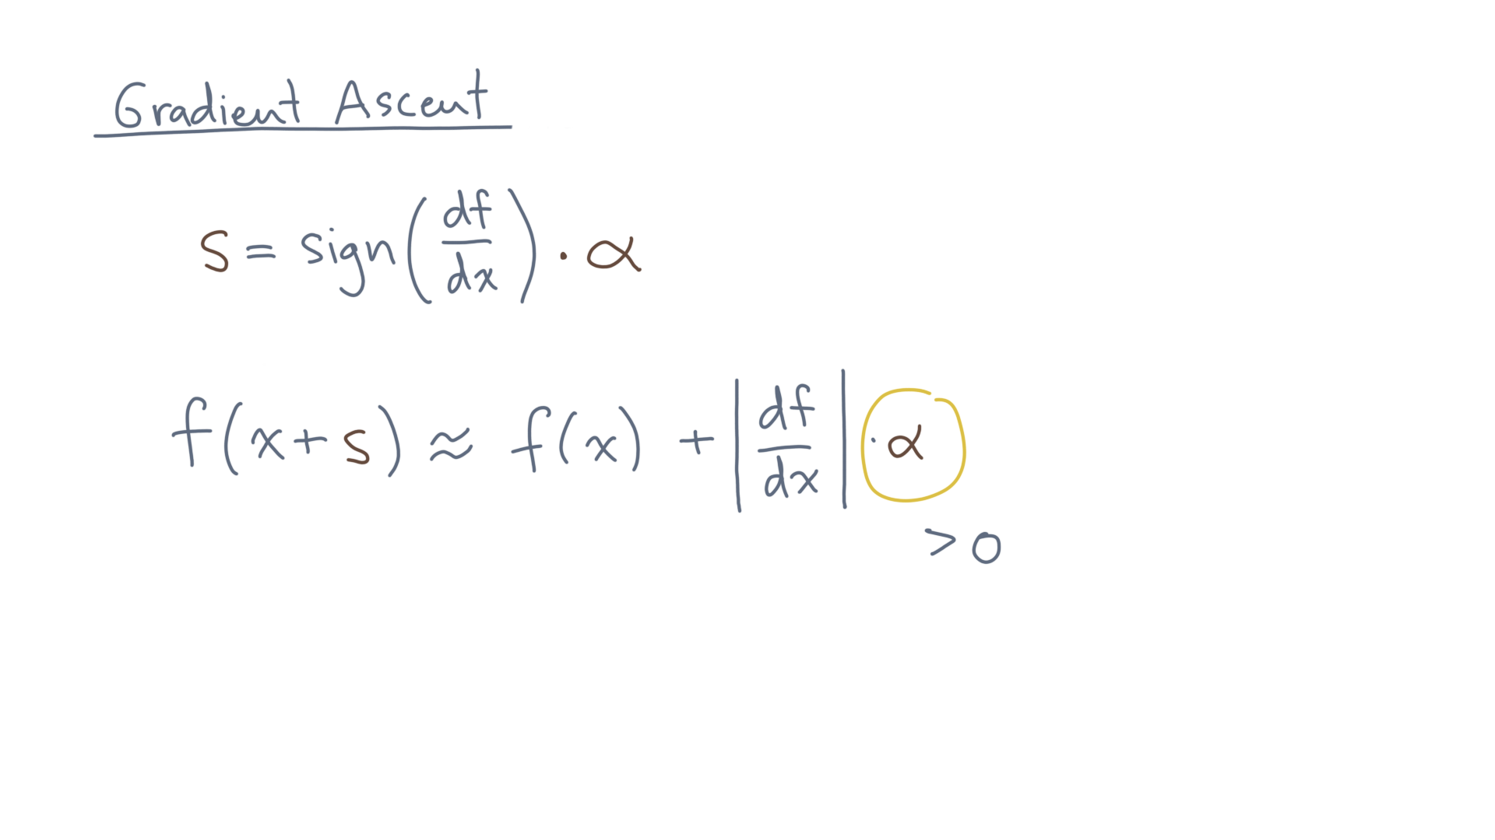
Notes:
Again, assuming that we ensure alpha is a positive value.

Slide 46
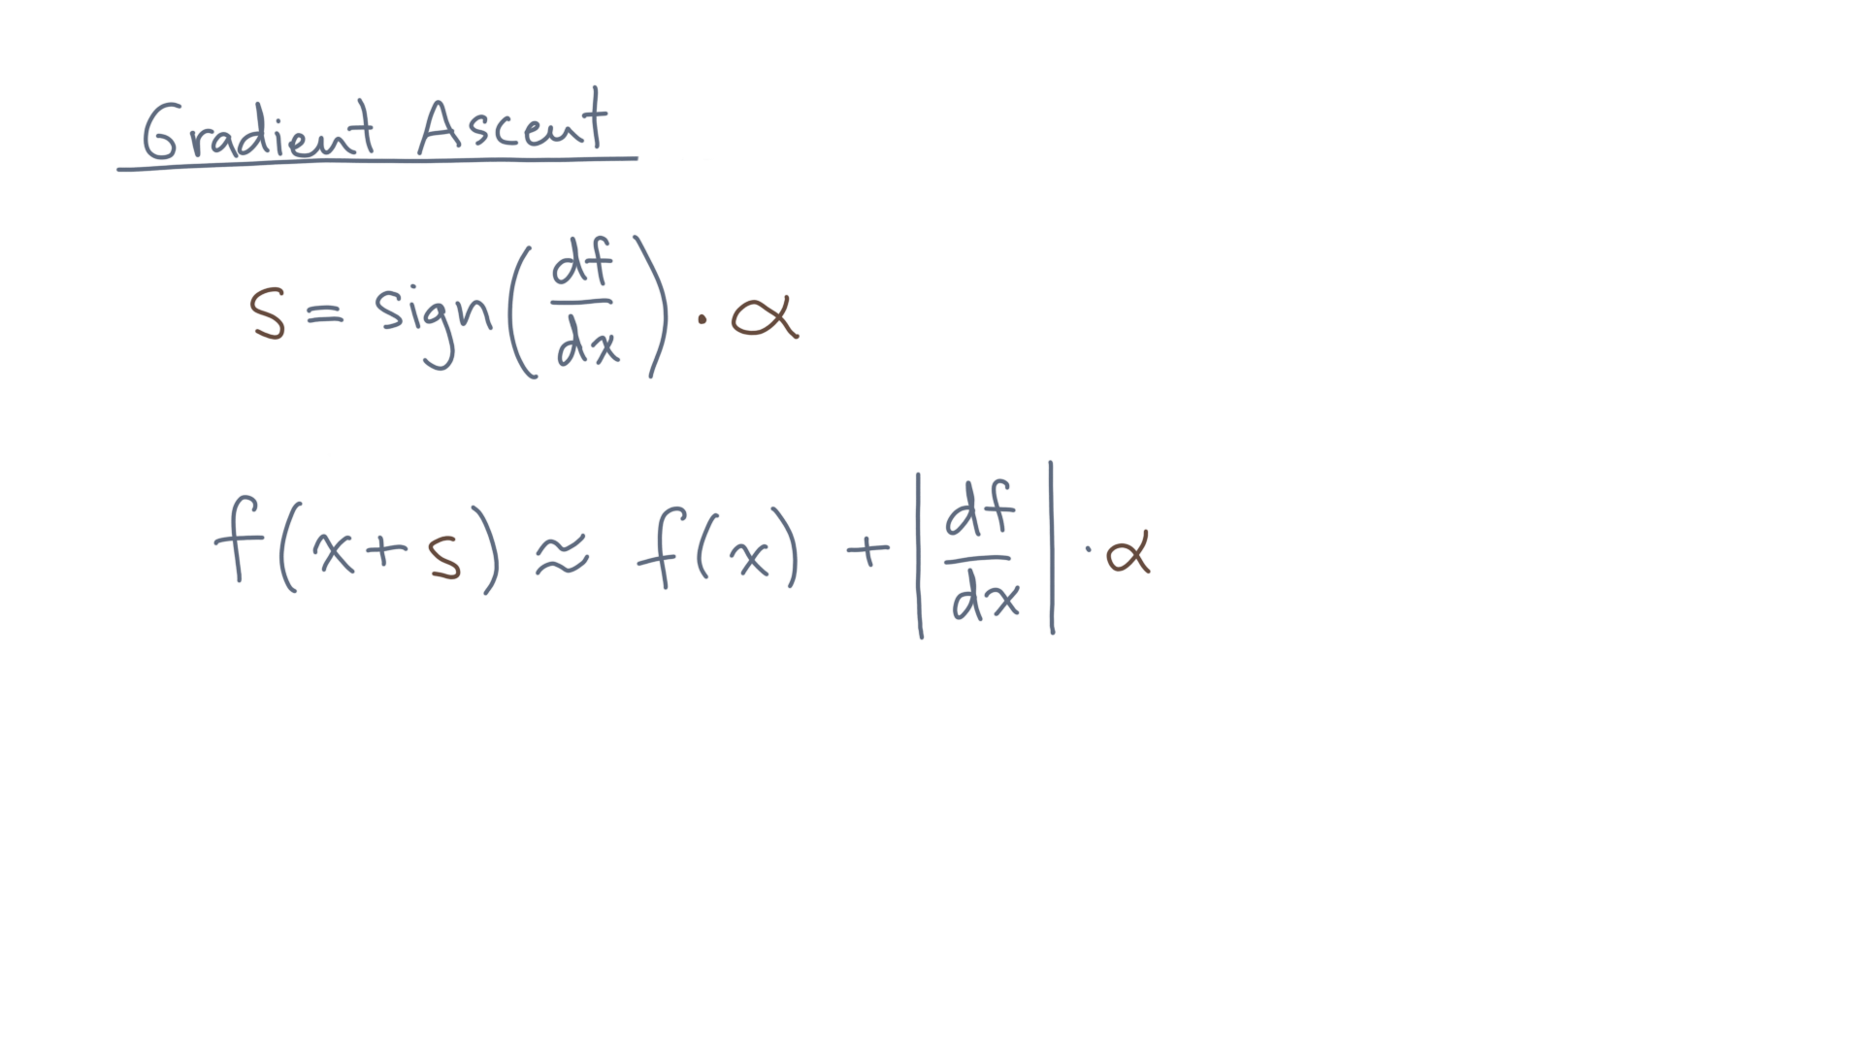
Notes:
That’s the 1-D case; what about higher dimensions?

Slide 47
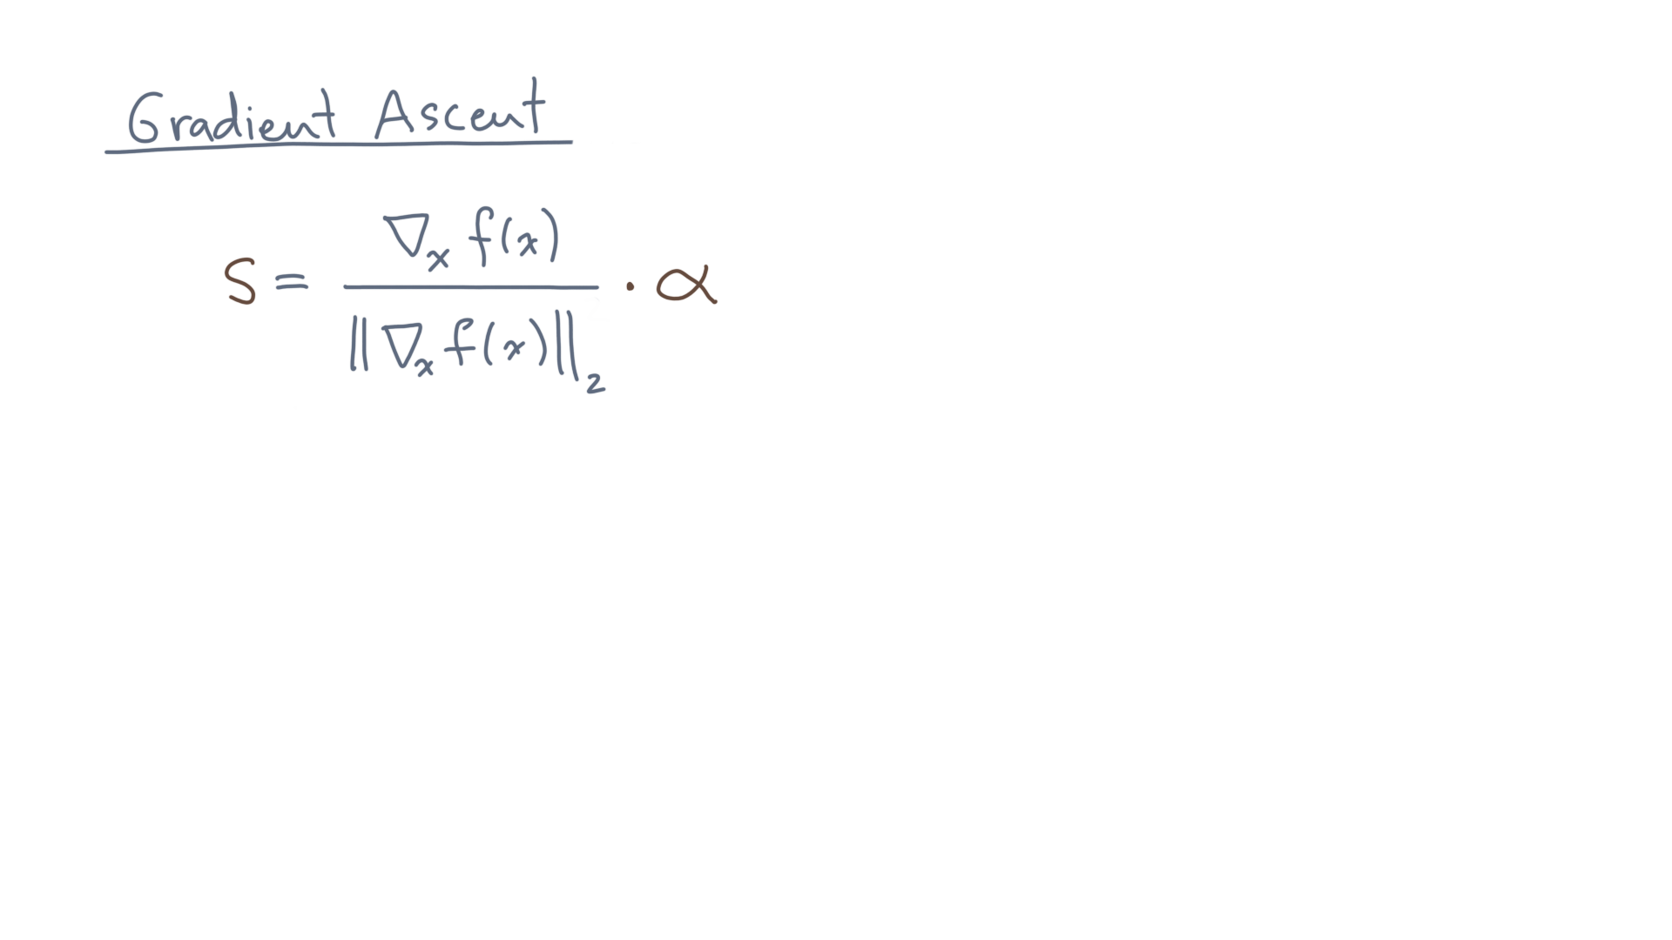
Notes:
The right step size is the gradient of f, normalized, and again times a scaling constant.

Slide 48
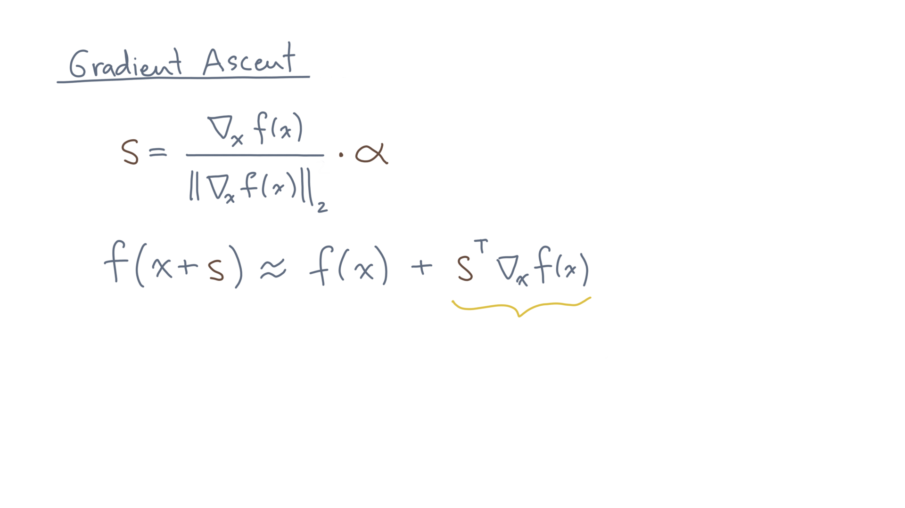
Notes:
You can determine that from the Taylor expansion in higher dimensions.
Which is f(x) plus s-transpose times the gradient of f.

Slide 49
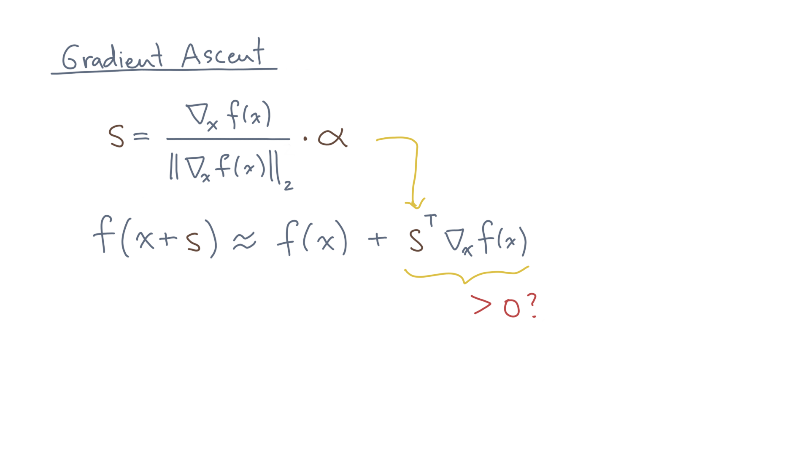
Notes:
Try plugging this step size into the first-order term of the Taylor expansion.
You’ll see that it makes this term positive, which is what you need to make progress toward finding the maximum.

Slide 50
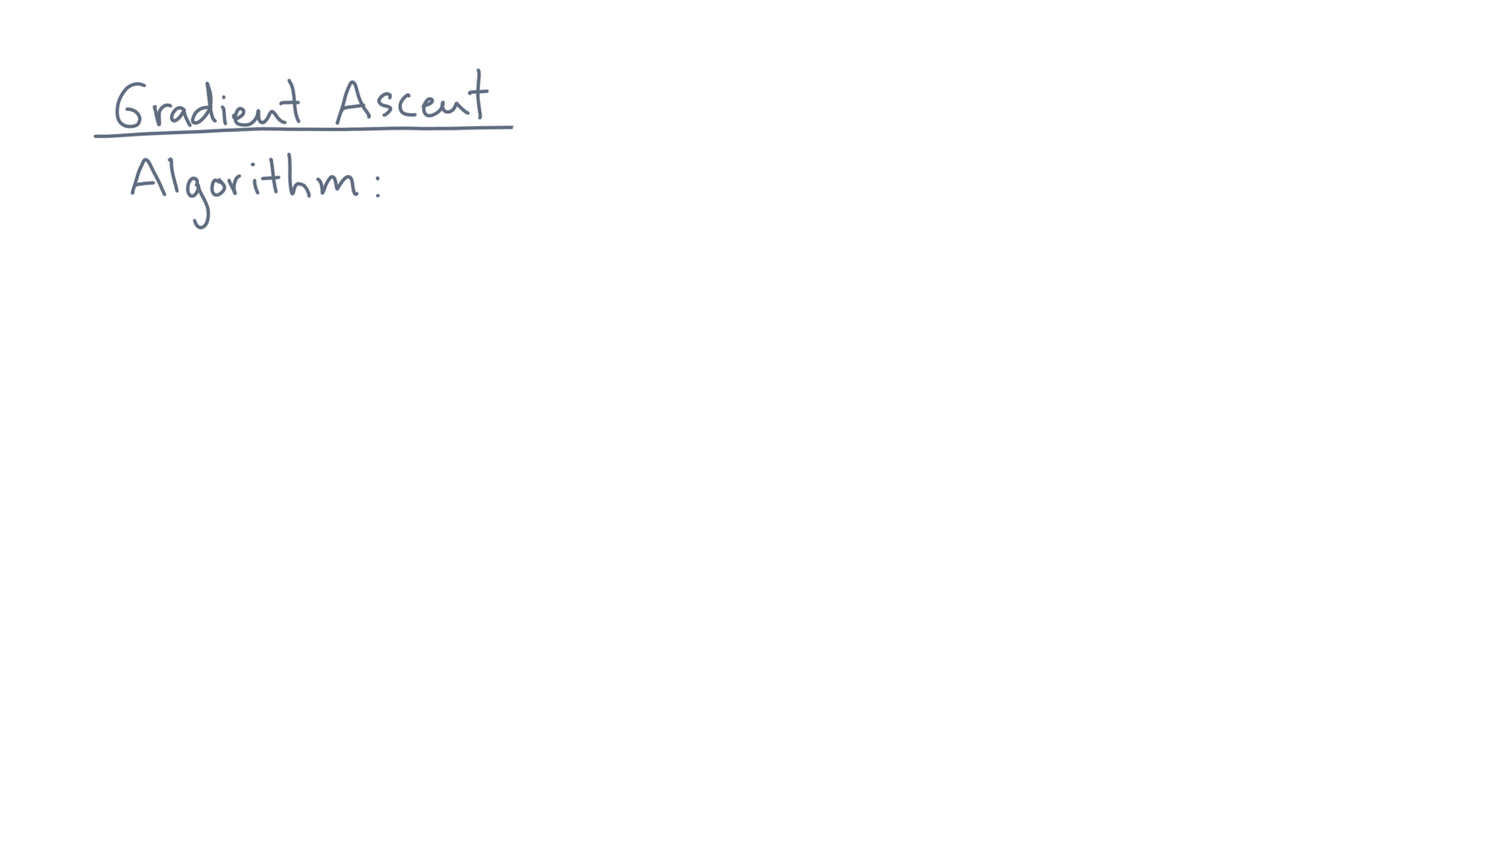
Notes:
Let’s summarize the gradient ascent algorithm.

Slide 51
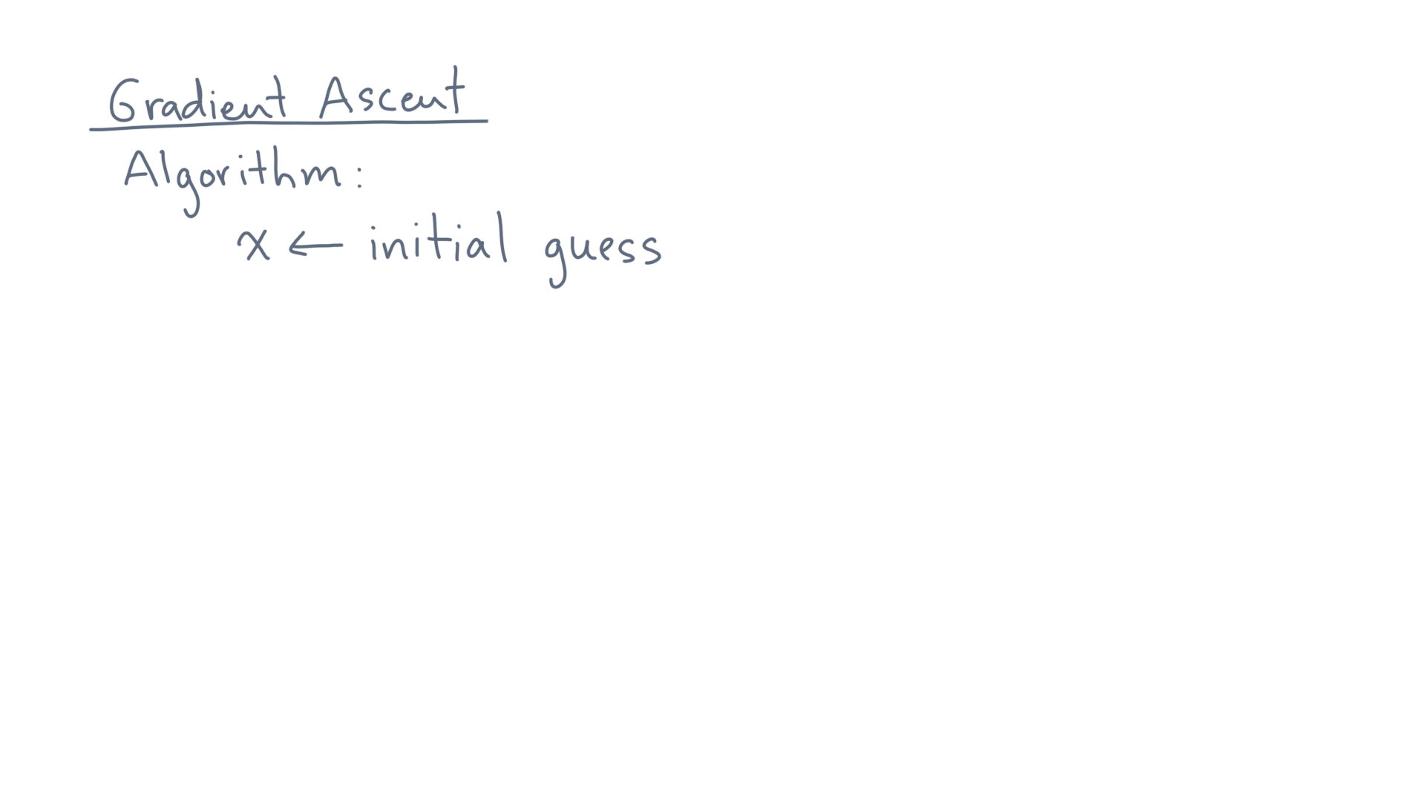
Notes:
Start with an initial guess.

Slide 52
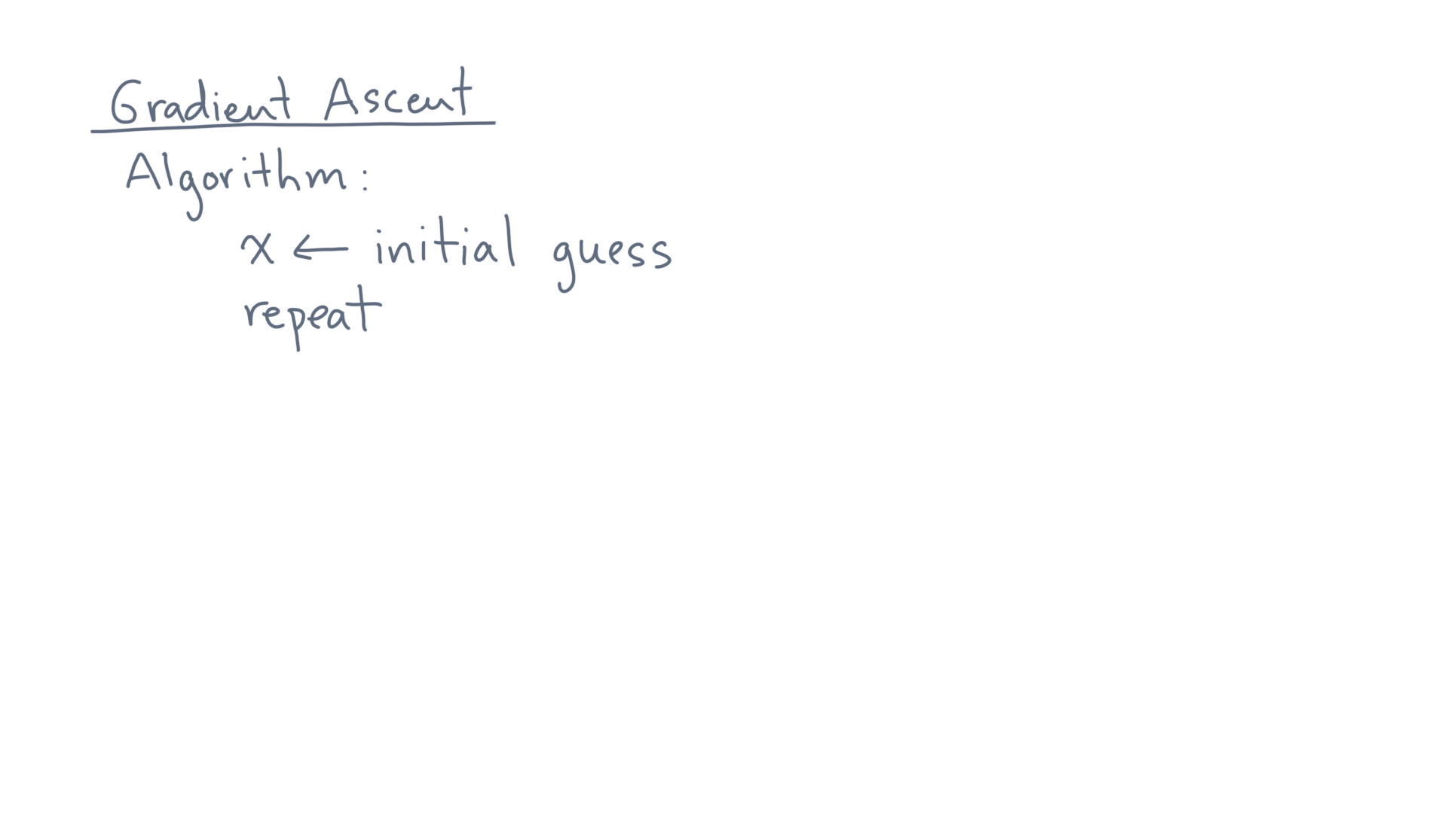
Notes:
Then repeatedly do the following:

Slide 53
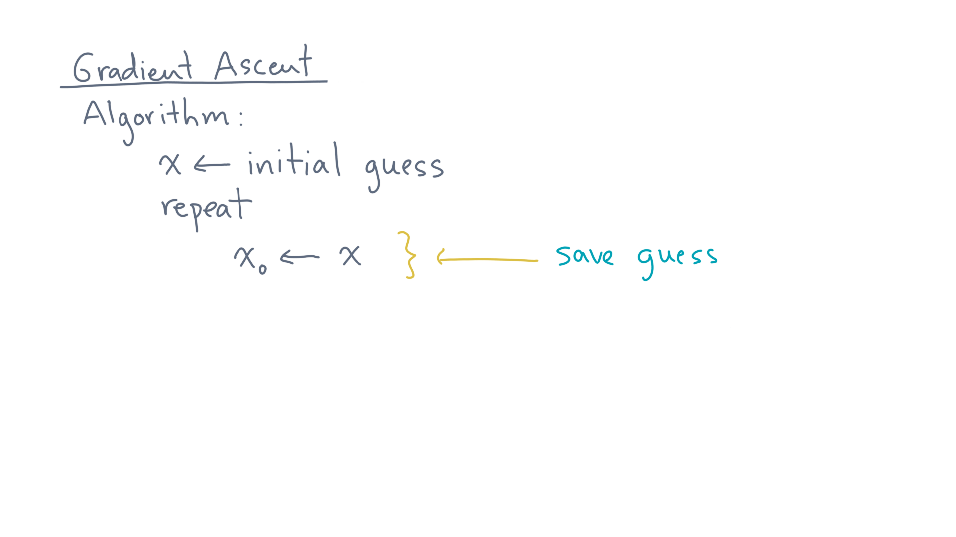
Notes:
Save the current guess.

Slide 54
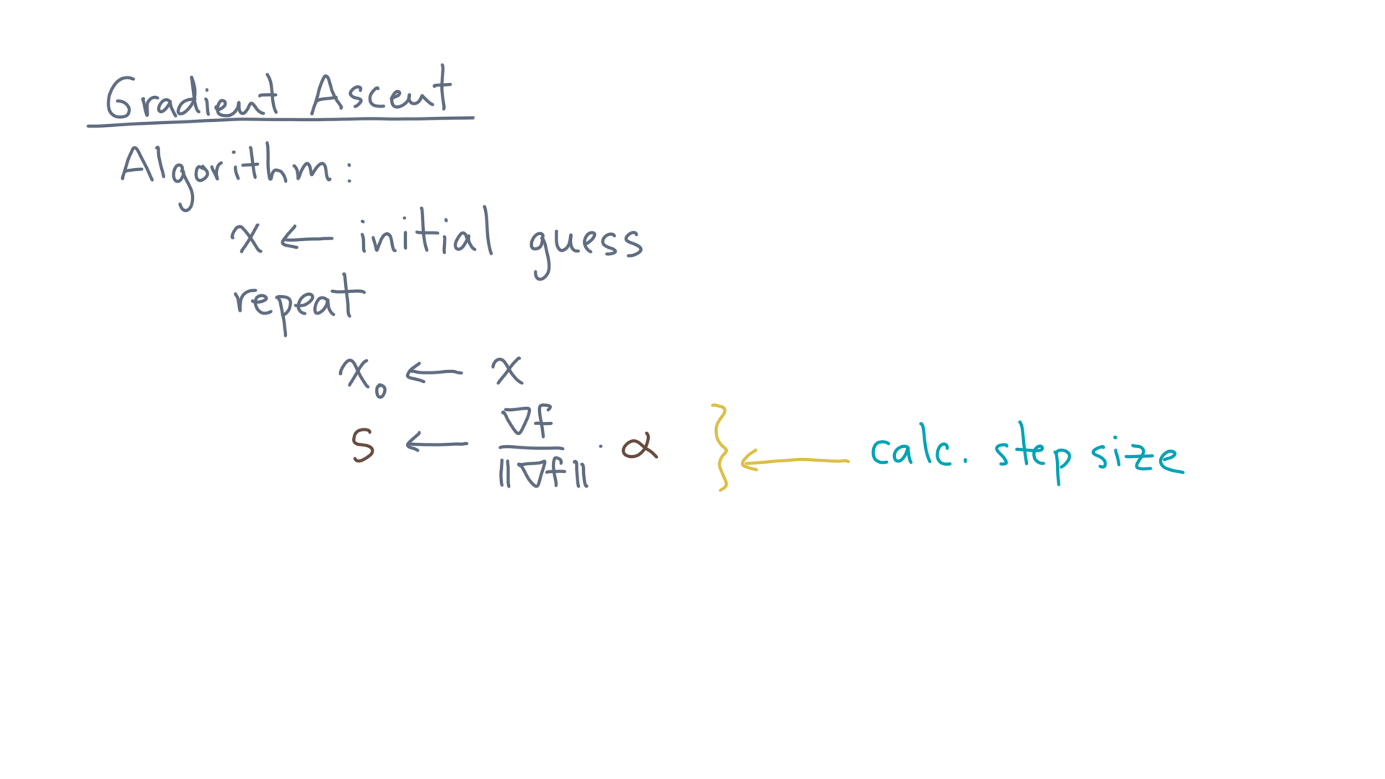
Notes:
Calculate the step size from the gradient.

Slide 55
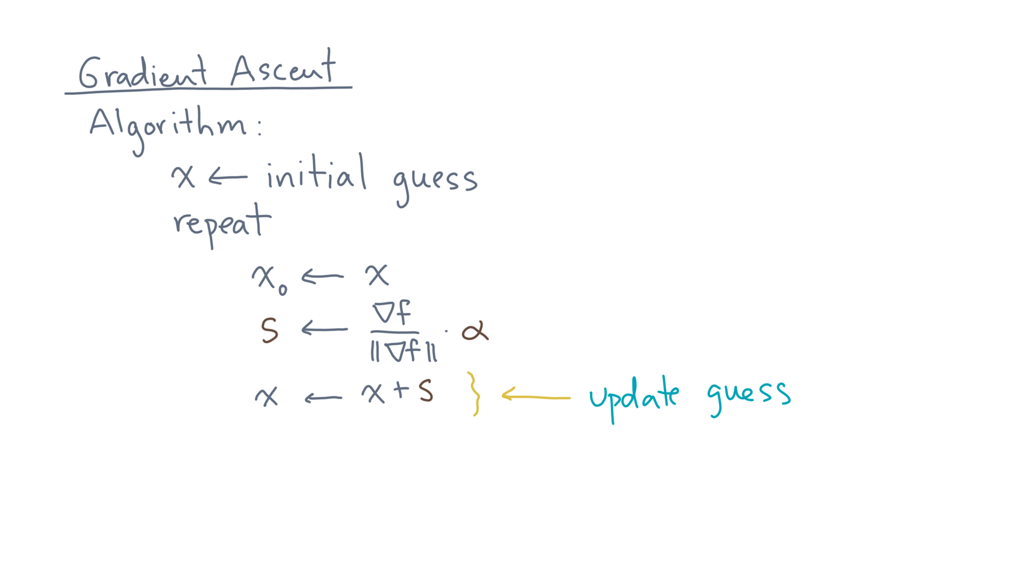
Notes:
Take a step of this size in this direction.

Slide 56
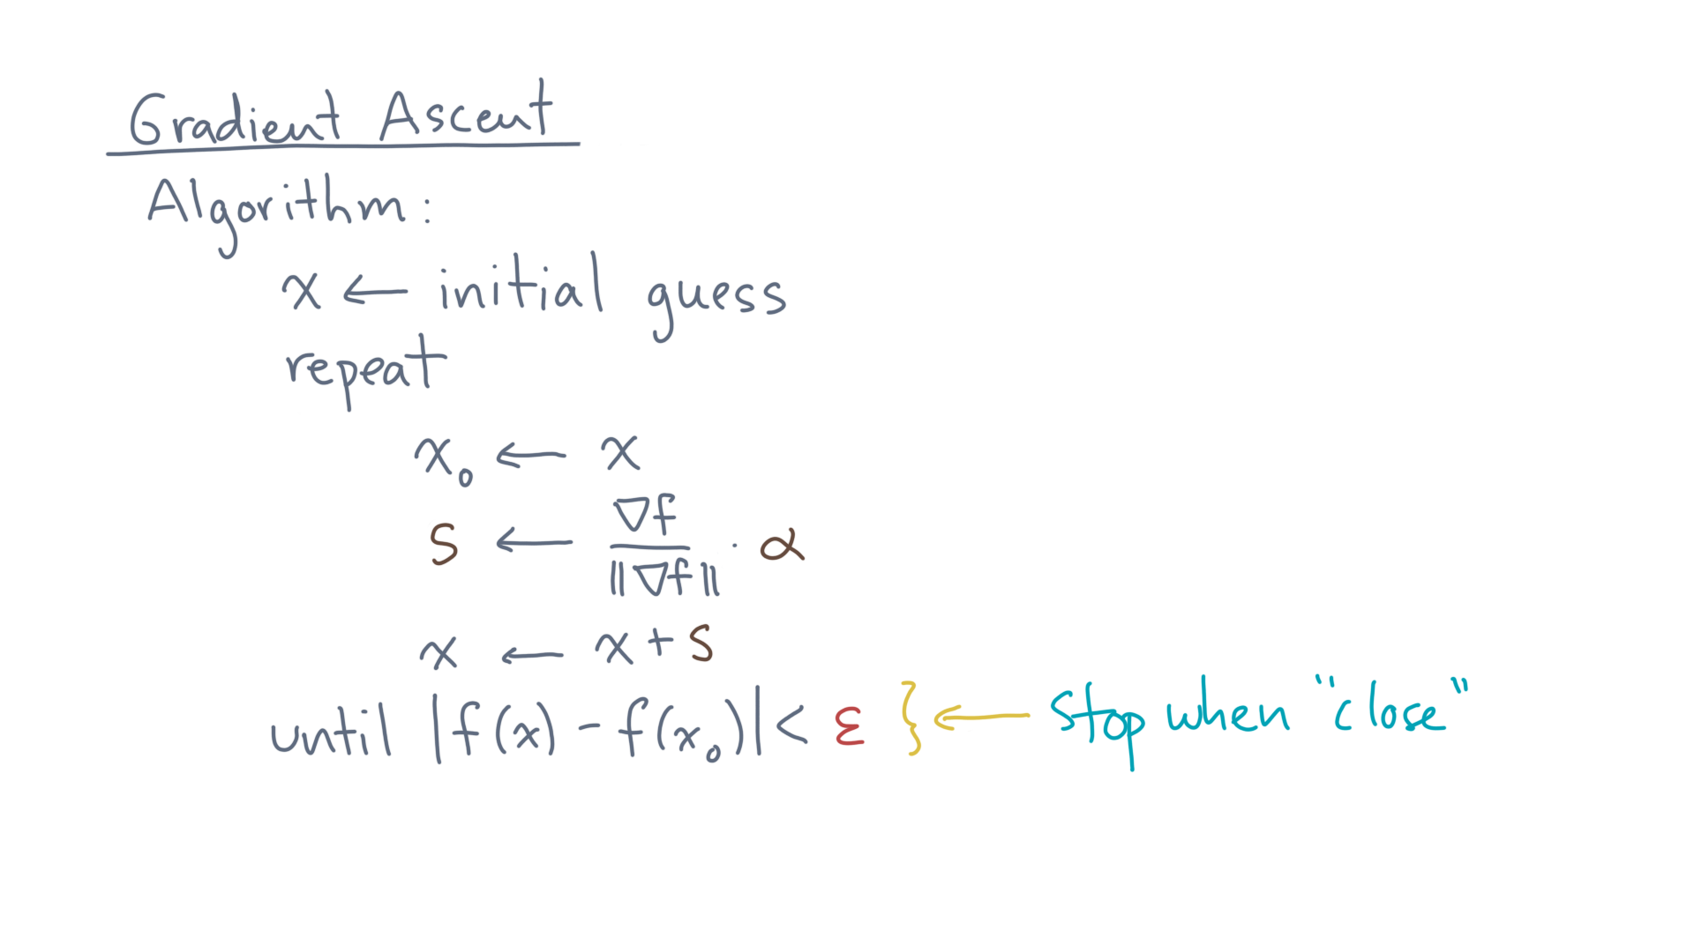
Notes:
And lastly, stop at some point.
There are different options for the stopping criteria, including taking a fixed number of steps or, as shown here, stopping when it doesn’t look like you are making any more progress.

Slide 57
Notes:
So that’s it – that’s the gradient ascent procedure.
To see whether you understand it, you should finish the notebook that accompanies this lesson.
It will have you apply gradient ascent to the problem of log-likelihood maximization, for the classification problem.

Slide 58
Notes:
The end result will be a complete algorithm for logistic regression.
You can then take that and apply it to your favorite classification problem, like beating your friends at lobster fights.
Mmmmm… lobster bisque…

